Slide 1
CARLOG: A Platform for Flexible and Efficient Automotive Sensing
Yurong Jiang, Hang Qiu, Matthew McCartney, William G. J. Halfond, Fan Bai, Donald Grimm, Ramesh Govindan
Sensys
2014
Notes:
Hello, everyone, my name is Yurong Jiang, from university of southern california.
Today I’m going to talk about an interesting problem of low-latency sensor fusion for vehicular apps.
This is a collaboration with GM researchers.

Slide 2
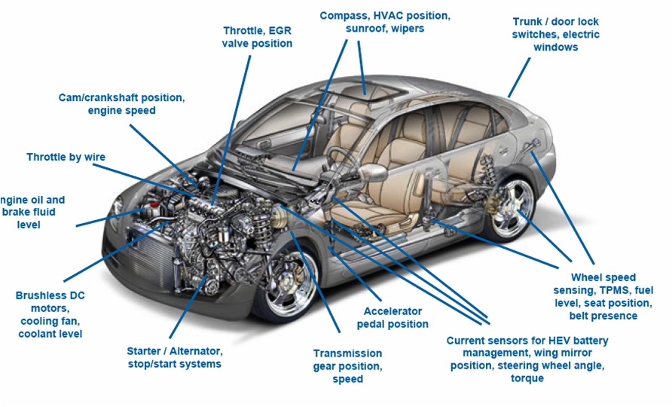
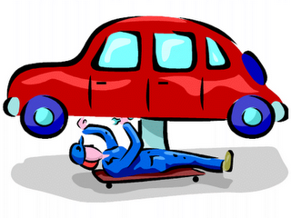
Automotive sensing
Safety
Comfort
Reliability
Performance
Automobiles come with hundreds of sensors
http://www.memsindustrygroup.org/files/public/April2010.htm
Motivation
Problem
Conclusion
Evaluation
Design
Notes:
A modern car is not just an engine with 4 wheels.
Modern vehicles are equipped with more than 200 hundred sensors to monitor low-level vehicle dynamics for the car’s health and performance.
These sensors can be used to design apps that improve safety, comfort, and performance, and reliability.
Manufacturers are considering opening many of those sensors to developers.

Slide 3
Automotive Sensing Apps
Event
Action
Automotive Event-driven Apps
Motivation
Problem
Conclusion
Evaluation
Design
Notes:
When app developers start developing sensor-based apps for cars, we think many of these apps will fall into the event -> action category. In this category, apps will try to detect events, and perform one or more actions when an event is detected.
For example, during wet roads and low visibility, an app can automatically turn on the wiper.
When we drive under dangerous conditions, an app can block calls and text messages.
If traffic is flowing smoothly and the weather is good, an app that turns on music or our favorite radio station would be very useful and interesting.
In this paper, we’re considered this special class of automotive apps, called event-driven apps, which detect events in near real time while monitoring car sensors.

Slide 4
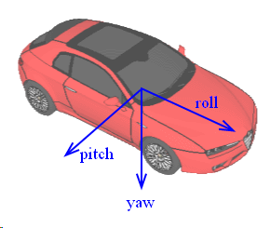
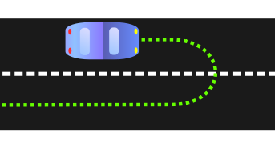
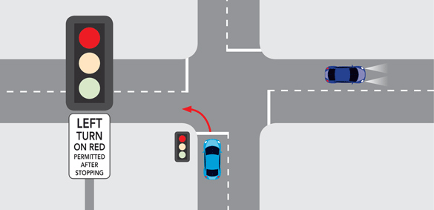
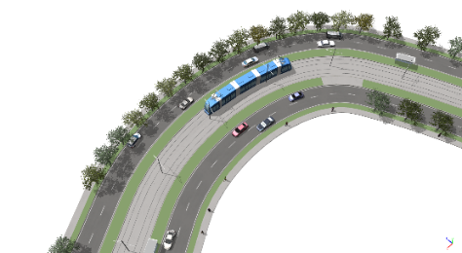
Cloud Sensing
traffic, terrain, weather, route, points of interest
How to detect illegal turn?
Intersection?
Curvature?
Motivation
Problem
Conclusion
Evaluation
Design
Notes:
Many such apps may also need information from the cloud in order to detect events.
Cloud-based databases can provide traffic, terrain, weather, and route information, as well as information about nearby points of interest.
To take a specific example, suppose an app developer wants to write an app to detect illegal turns. This could be useful for parents to monitor their children’s driving behavior. To do this, local car sensors such as the wheel angle and yaw rate sensor can be used to determine when the car turns, but not all turns are illegal.
A turn at an intersection, or a turn on a curvy mountainous road, are legal, so the app should rule these out. Thus to program this illegal turn event, the app may need cloud information.

Slide 5
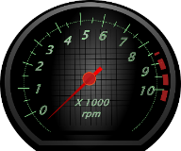
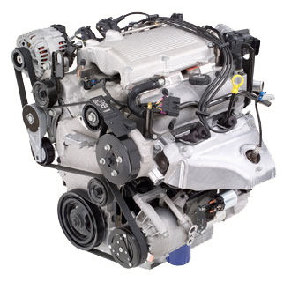
Programming events: difficult and tedious
Hundreds of car sensors
Each gives limited information about a local aspect of the car
Cloud sensors provide more contextual information
But services have widely varying interfaces
Motivation
Problem
Conclusion
Evaluation
Design
Notes:
But programming events in vehicular sensing-based apps can be difficult and tedious.
First, there are hundreds of car sensors for individual car, and each sensor gives limited information about a local aspect of the car. For example, RPM sensor gives information about the engine, steering wheel angle tells you the angle when the steering wheel is turned.
Second, cloud sensors provide more contextual information (traffic, weather), but cloud services have widely varying interfaces. For example, event descriptions may need map and traffic information from google, weather information from accu weather, gas price information from another provider etc.

Slide 6
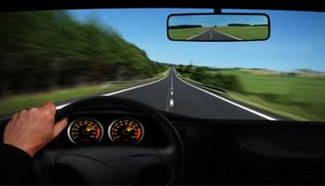
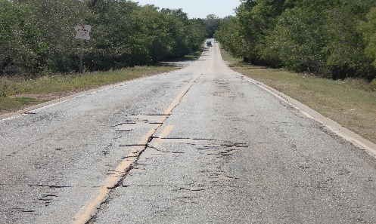
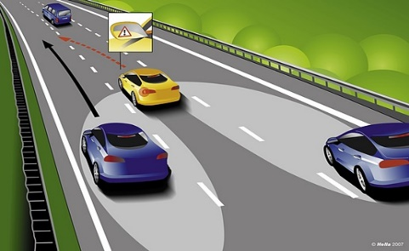
Programming Scenario
Dangerous Driving
Bad weather condition?
Speeding?
Poor Road Condition?
Aggressive Turn?
use a declarative programming language
Motivation
Problem
Conclusion
Evaluation
Design
Notes:
In addition, events can have many complex sub-conditions that need to be taken into account, as we saw with the illegal turn example.
Another example is an event detection that attempts to detect dangerous driving.
For this, an app developer needs to consider if the weather is bad, if the driver is speeding, if the road conditions are poor, and if the driver is performing aggressive turns or lane changes. These conditions all contribute to dangerous driving.
One way to simplify the programming of such events is to use a declarative programming language like Datalog.

Slide 7
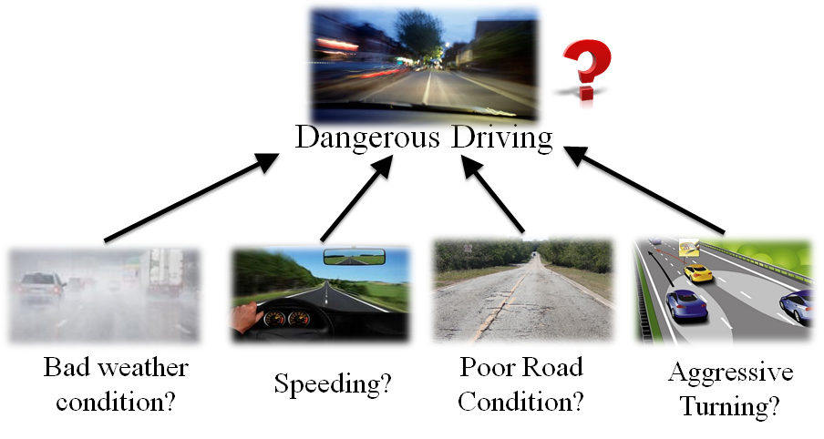
Datalog
declarative logic programming language
programs are written as predicates in first-order logic
Rule
Facts
$$Speeding\left(x,y,z,w\right):−$$
$$vehiclespeed\left(z\right), speedlimit\left(w\right), z>1.2w.$$
$$DangerousDriving\left(x,y,z,w\right):−$$
y$awrate\left(x\right), x>15,weather\left(y\right), y=False, Speeding(y,z), road\left(r\right), r=False.$
Support negation and recursion, widely used
Highly mature logic programming language
Rule re-use
Conjunctive
Motivation
Problem
Conclusion
Evaluation
Design
Notes:
CarLOG builds upon Datalog, a logic programming language in which programs are written as predicates in first-order logic.
Such predicates are useful for describing events.
To see why, consider the previous dangerous driving example expressed in Datalog.
This definition, which consists of two Datalog rules, defines speeding with one rule and dangerous driving with another rule.
The dangerous driving rule uses the speeding rule.
The dangerousdriving rule corresponds to the intended event, and bad weather condition is expressed by this predicate, and so on.
This rule can be understood in the following way: dangerousdriving is true, if all the conditions: yawrate>15, weather=false, vehiclespeed >1.2*speedlimit, and speeding are true. In general, a datalog program contains two constructs, the rule, and facts. Facts are defined using predicates. Here are the predicates from car and these are from the cloud. Those predicates are conjunctive meaning that all those conditions need to be satisfied in order to determine the rule is true.
Datalog has several benefits: First it’s a highly mature logic programming language
second, it supports negation and recursion and widely used in information extraction. Finally, we can re-use rules as shown in this example.
NOTES: make it bullets. Remove animation,
Move conjunctive box below the rule

Slide 8
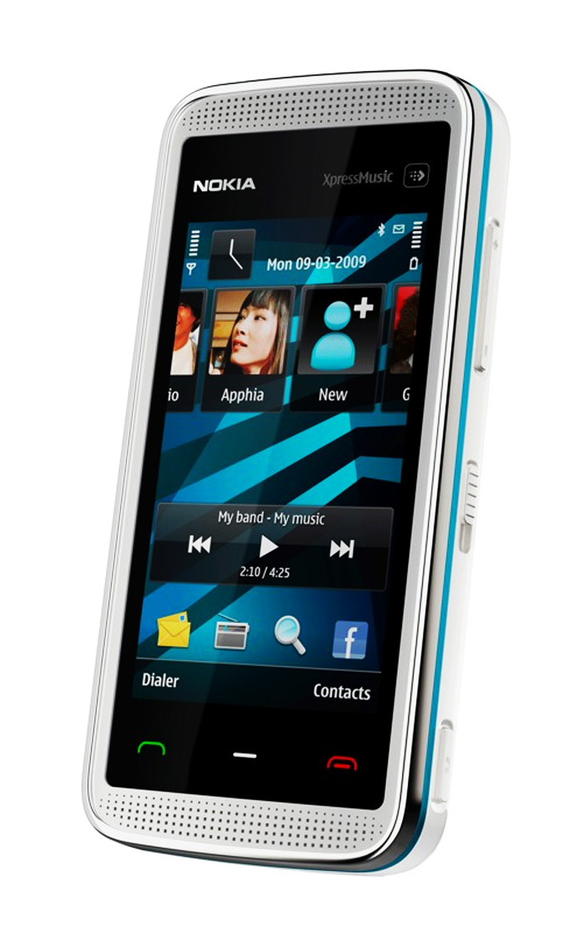
Predicate Acquisition Latency
$$Speeding\left(x,y,z,w\right):−vehiclespeed\left(z\right), speedlimit\left(w\right), z>1.2w.$$
$$DangerousDriving\left(x,y,z,w\right):−$$
y$awrate\left(x\right), x>15,weather\left(y\right), y=False, Speeding(y,z), road\left(r\right), r=False.$
weather?
speedlimit?
road?
yawrate?
speed?
yawrate=10
speedlimit=30
speed=35
weather=False
road=False
10 ms
Predicate Acquisition Latency
100 ms
400 ms
600 ms
Cloud acquisition latency dominates with large variance
800 ms
Motivation
Problem
Conclusion
Evaluation
Design
Notes:
Datalog executes a program by evaluating its rules. Rule evaluation in datalog works as follows.
The datalog engine evaluates each predicate one-by-one.
In our setting this means that the sensors corresponding to predicates are retrieved in order.
Acquiring each sensor incurs latency. To understand this, we look at how datalog works for this example, the phone sends request for sensors to car and cloud, and wait for value to return.
First, the yawrate sensors and speed sensors take, say 10ms and 100ms to be retrieved (because of their sampling rate). Then, we get the weather, speedlimit and road conditions back from cloud at different times, say 400ms to 800ms later after request. We call this delay the predicate acquisition latency.
This predicate acquisition latency is generally dominated by acquiring cloud information, and this latency can have high variance.
NOTES: why cache not work here? Through away unnecessary evaluation,
What optimization, not necessary bandwidth, don’t want unnecessary query. Time,
Phone will not query frequent, bounded on cost, assumption, not practical, real time on demand query.
Hidden cost, metric, because of this,
We assume the information is correct, is larger than the time window to evaluate the query.

Slide 9
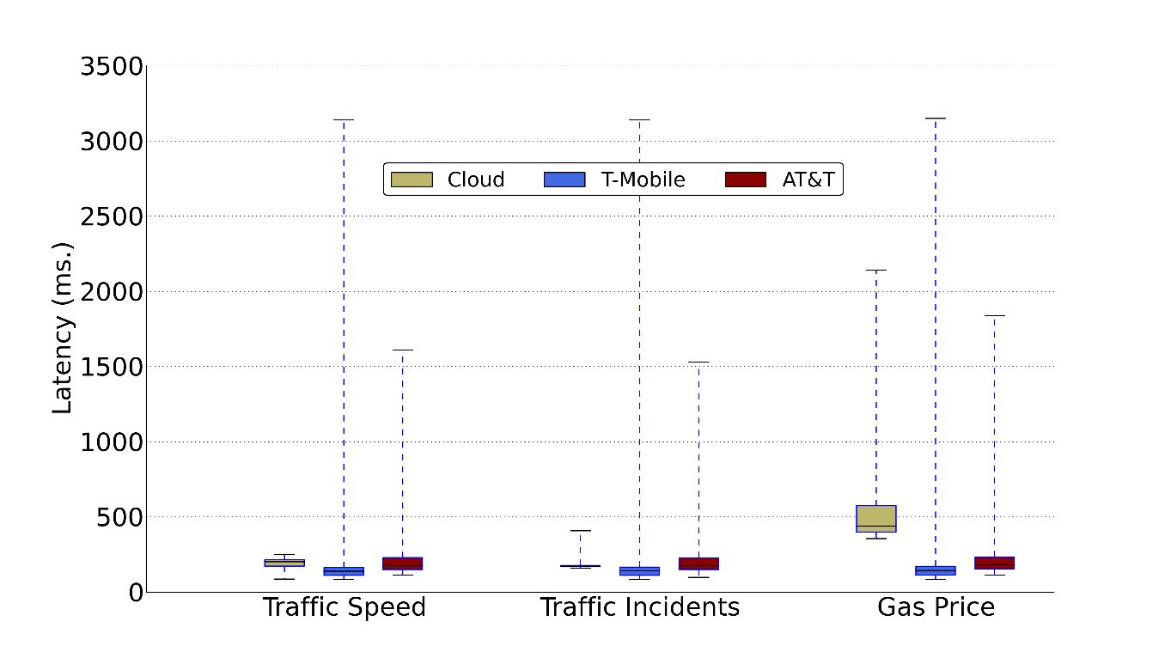
Real World Predicate Acquisition Latency
Study of Cloud Predicate Latency
Avg 30mph (max 70mph)
3 different providers
2 cellular carriers
Predicate Acquisition Latency
Network latency highly variable, seconds delay in worst case
Motivation
Design
Evaluation
Conclusion
Problem
Notes:
To quantify cloud latency in practice, we study cloud predicate access latency for three different cloud services. We drove on some local streets and highways at an average of 30 mph, and timed the acquisition latency for three different cloud services (Google, Bing and gasbuddy) on two different carriers Tmobile and ATT.
This figure shows the variation of latency, with the mean latency across different services being about 1s and the worst-case latency being several seconds.
This latency can affect the timeliness of Datalog’s predicate evaluation. Optimizing this latency is the primary focus of our paper.
NOTES: legend bigger,
NOTES: stop in end of sentence, make clear to speak.

Slide 10
CARLOG Contributions
Experiments show that CARLOG misses fewer events and has lower latency than competing strategies
Algorithms for optimizing predicate acquisition latency
CARLOG system design and implementation
Motivation
Design
Evaluation
Conclusion
Problem
Notes:
This paper makes three main contributions.
First, we have developed and explored different methods to optimize the latency of predicate acquisition in CarLOG.
Second, we have designed and implemented the CarLOG system, which contains the predicate optimizations implemented in a publicly available Datalog engine.
Finally, we have conducted an extensive evaluation, using our prototype, and using trace driven evaluation. Our results show that CarLOG outperforms several other candidate strategies, in some cases by an order of magnitude.
We begin by describing our first contribution.

Slide 11
CARLOG Latency Optimization
$$Speeding\left(x,y,z,w\right):−vehiclespeed\left(z\right), speedlimit\left(w\right), z>1.2w.$$
$$DangerousDriving\left(x,y,z,w\right):−$$
y$awrate\left(x\right), x>15,weather\left(y\right), y=False, Speeding(y,z), road\left(r\right), r=False.$
10 ms
yawrate=10
100 ms
speed=35
> 800 ms
400 ms
speedlimit=30
600 ms
road=False
10 ms !
Short-circuit Boolean predicate evaluation
800 ms
weather=False
Motivation
Design
Evaluation
Conclusion
Problem
Notes:
This slide explains the key idea behind our latency optimization. As we explained before, the Datalog predicate evaluation first acquires the sensor readings, and then evaluates the predicate. In our example, this can take much longer than 800 ms to evaluate this predicate.
However, it is possible to achieve much lower latency in some cases. For example, if the yawrate sensor reading is less than 15, then we know that the dangerous driving is false because these predicates are conjunctive. Since the yawrate sensor can be acquired in 10ms or less, this results in a significantly lower acquisition latency.
This short-circuit predicate evaluation idea has been studied in many other contexts before, but not in this setting. We will show next that novel variants of the problem exist in this setting.

Slide 12
CARLOG Latency Optimization
$$Speeding\left(x,y,z,w\right):−vehiclespeed\left(z\right), speedlimit\left(w\right), z>1.2w.$$
$$DangerousDriving\left(x,y,z,w\right):−$$
y$awrate\left(x\right), x>15,weather\left(y\right), y=False, Speeding(y,z), road\left(r\right), r=False.$
Dangerous
Driving
G1
G2
G3
yawrate > 15
weather = False
road = False
Speeding
Probability:
$$p_{2}$$
$$p_{1}$$
$$p_{3}$$
Probability represents the predicate’s likelihood to be true
Cost represents the average predicate latency
Cost:
$$C_{2}$$
$$C_{1}$$
$$C_{3}$$
G4
vehiclespeed
> 1.2 speedlimit
$$p_{4}$$
$$C_{4}$$
Motivation
Design
Evaluation
Conclusion
Problem
Notes:
To understand how CarLOG’s latency optimization works, we first model the problem as follows. We expand the dangerous driving rule into a representation called a proof tree where the rule head is the root, and other predicates are leaves. In our example, the rule for speeding forms a subtree in this proof tree.
To simplify the notation, we label each predate as G1, G2, G3, G4. Suppose that each predicate has an associated probability and an associated cost. The probability represents the predicate’s likelihood of being true, and the cost represents the average predicate latency.
NOTES: change color of black blue.
NOTES: you can not get all the information from cloud for parallel. We can optimize with short-circuit.

Slide 13
CARLOG Latency Optimization
Estimated from driving traces
G1
G2
G3
G4
Probability
Cost
Measured directly
$$p_{1}=0.4$$
$$p_{2}=0.1$$
$$p_{3}=0.2$$
$$p_{4}=0.5$$
$$C_{1}=10$$
$$C_{2}=800$$
$$C_{3}=600$$
$$C_{4}=400$$
Order | Expected Cost
G1,G3,G4,G2 | 314
G1,G4,G3,G2 | 502
G2,G3,G1,G4 | 863.4
G1,G2,G3,G4 | 357.2
… | …
Challenges: Finding the predicate order that minimizes expected latency
Motivation
Design
Evaluation
Conclusion
Problem
Notes:
The predicate’s probability is estimated from driving traces, and cost is directly measured on a mobile devices.
To illustrate the benefits of our latency optimization, assume we have the predicates with following numerical values. If we evaluate them in different order, we achieve different predicate acquisition latencies. The tables shows several different evaluation orders, and the best order is G1,G3,G4,G2 with smallest expected cost.
The key challenge our paper addresses is how to calculate these optimal evaluation orders.
NOTE: Cost and probability, a concrete example, show how it works

Slide 14
Latency Optimization Problems
Single conjunctive query
Single query w/ Negation
Multiple queries w/o Negation
Motivation
Design
Evaluation
Conclusion
Problem
Notes:
Our latency optimization algorithms consider three different settings, in increasing order of complexity: optimizing a single conjunctive query, optimizing a single query with negation, and jointly optimizing multiple queries without negation.
We discuss each of these in detail in the next few slides.

Slide 15
Single Conjunctive Query
Rule with N predicates
Rule
G1
G2
$$…$$
GN
Probability:
$$p_{1}$$
$$p_{2}$$
$$p_{N}$$
$$…$$
Cost:
$$C_{1}$$
$$…$$
$$C_{2}$$
$$C_{N}$$
Optimal Order Follows:
R. Greinera, R. Haywarda, M. Jankowska, M. Molloy. Finding Optimal Satisficing Strategies for And-Or Trees. Artificial Intelligence. 2006
Motivation
Problem
Evaluation
Conclusion
Design
Notes:
We first consider optimizing a single conjunctive rule with N predicates. This problem is well known in the literature and others have proposed a solution for this, where the optimal evaluation order is greedy, evaluating predicates in the order of lowest ratio, which is cost/(1-probability). Intuitively, if a predicate has a low-cost and a low probability of being true, it should be evaluated first.

Slide 16
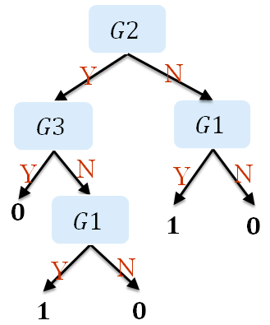
Single Query w/ Negation
Decision Tree
R$\left(x,y,z\right):−$ G$1\left(x\right), NOT{ R}_{1}(y,z)$
$R_{1}\left(y,z\right):−$ G$2\left(y\right),G3(z)$
R
NP
NOT
Special Case: NO interleaving
G1
$$R_{1}$$
$$p_{1}$$
G2
G3
G2,G3:${ 1−p}_{2,3},C_{2,3}$
G1
G2
G3
$$C_{1}$$
$$p_{2}$$
$$p_{3}$$
Computing the effective probability and effective cost of the negated sub-tree
min($\frac{C_{1}}{(1−p_{1})}$, $\frac{C_{2,3} }{(p_{2,3})})$ first
$$C_{2}$$
$$C_{3}$$
$$…$$
Motivation
Problem
Evaluation
Conclusion
Design
Notes:
Many Datalog engines support negation, and negation is useful for expressing many rules (like the illegal turn rule we saw earlier. This slide shows an example of a datalog rule with negation.
In this case, we see that R1 is a subrule that contains two predicates G2,G3, and R1 is negated in rule R. The proof tree for this rule now contains a NOT.
Finding the optimal evaluation order in this case is known to be NP complete.
However, in some special cases, it is possible to find optimal evaluation orders. For example, consider the case in which predicates in a negated subtree cannot be interleaved with predicates from outside the subtree. For this special case, in our example, G1 cannot be interleaved between G2 and G3. For this case, we can compute an optimal ordering, by computing the effective probability and effective cost of the negated subtree. Then we apply the previous algorithm recursively to find the minimum ratio. In this case, the output of this algorithm is a decision tree, where the evaluation order depends upon the value of the predicate.
We have proved this algorithm to be optimal, more details can be found in the paper.

Slide 17
Multiple Queries w/o Negation
$R_{1}\left(x,y\right):−$ G$1\left(x\right), G2(y)$
$R_{2}\left(y,z\right):−$ G$2\left(y\right),G3(z)$
$$R_{1}$$
$$R_{2}$$
$$G1$$
$$G2$$
$$G2$$
$$G3$$
$p_{1}$=0.39
$p_{2}$=0.14
$p_{2}$=0.14
$p_{3}$=0.71
$C_{1}$=201
$C_{2}$=404
$C_{2}$=404
$C_{3}$=278
Individual Optimization
G2 First?
Heuristic Greedy Evaluation:
NP
Combined optimization outperforms individual optimization
$$Optimal Cost for R_{1}$$
min($\frac{C_{1}}{(1−p_{1})}$, $\frac{C_{2} }{2(1−p_{2})}$, $\frac{C_{3}}{(1−p_{3})})$ first
Iterate until finish
521.6
$$Combined Cost for R_{1 }\& R2$$
471.1
$$Optimal Cost for R_{2}$$
643.9
$$…$$
Motivation
Problem
Evaluation
Conclusion
Design
Notes:
In our CarLOG setting, apps can have multiple event descriptions that can be concurrently and continuously evaluated. In this case, the Datalog engine evaluates multiple queries concurrently.
Consider two rules whose proof tree and the associated costs and probabilities are shown in the figure. If we evaluate the two rules separately, the cost is as follows, we notice that G2 is shared among two rules, if we jointly optimize the two rules by first evaluating the common predicate G2, we achieve a much lower latency than any individual evaluation.
This joint optimization outperforms individual optimization, but the problem of finding the optimal evaluation order is NP-hard, which can be proved by reduction from set cover. We proposed a heuristic greedy evaluation strategy. This strategy evaluates by lowest c/(1-p), the difference is that we add the number of predicate appearance in the rules as a weighted factor in front of (1-p). In this example, the factor is 2.
To our knowledge, multi-query optimization has not been considered in the literature before.
NOTES: highlight 2, change

Slide 18
CARLOG Contributions
Experiments show that CARLOG misses fewer events and has lower latency than competing strategies
Algorithms for optimizing predicate acquisition latency
CARLOG system design and implementation
Motivation
Problem
Evaluation
Conclusion
Design
Notes:
Having described our first contribution, I now briefly describe the CarLOG software architecture. A more detailed description can be found in the paper.

Slide 19
CARLOG Architecture
Prototype
App 1
App 2
…
Sensor Acquisition
Query processing
Optimized Datalog
Java (14,084 lines)
Java (6,639 lines)
CARLOG Mobile
Rules
Query
Optimizer
Interface
CARLOG
Sensor
List
Order
Cloud
Acquisition
Sensor
Acquisition
Query Plan Evaluator
Acquisition
CARLOG Cloud
OSM, Weather, Traffic, PoI, Traffic Speed, etc
PHP (700 lines)
Weather=Bad
0D 28 …
Motivation
Problem
Evaluation
Conclusion
Design
Notes:
CarLOG contains several components.
The interface component provides api for apps, and interacts with other components.
The sensor acquisition component acquires car sensors using Bluetooth. The cloud acquisition module provides an interface for accessing various kinds of cloud predicates. The query optimizer module takes the rules and optimizes these to get the evaluation order or decision tree. The query plan evaluator will evaluate the rule based on the result of query optimizer, and interact with interface for cloud request and result update.
Our implementation is separated to two parts, the CARLOG Mobile in the client, and cloud acquisition part in server. CarLOG mobile contains the sensor acquisition and query processing is implemented in Java and contains a modified Datalog engine. The cloud-side implementation provides a unified front-end to a variety of web services.
NOTES: Interface provides, show each components. And remove animations

Slide 20
CARLOG Contributions
Experiments show that CARLOG misses fewer events and has lower latency than competing strategies
Algorithms for optimizing predicate acquisition latency
CARLOG system design and implementation
Motivation
Problem
Design
Conclusion
Evaluation
Notes:
Finally, we now describe our third contribution, an evaluation of CarLOG which uses both experiments with our prototype and trace driven evaluations to compare CarLOG against several other strategies.

Slide 21
CARLOG Evaluation
Event Definition
Methodology
Existing Apps, Driving Experience
26 Rules. Avg. 3.6 sensor predicates, 2.3 cloud predicates
2,000 miles, 2 GB data
Trace-driven comparison
Motivation
Problem
Design
Conclusion
Evaluation
Notes:
In our evaluations, we defined 26 rules with, on average, 3.6 car sensor predicates, and 2.3 cloud predicates. These rules were derived from existing automotive apps, as well as based on our own driving experience.
Our trace-driven comparison methodology uses 2GB of traces obtained by driving over 2,000 miles.
notes: make new slides of metrics after slide 29,

Slide 22
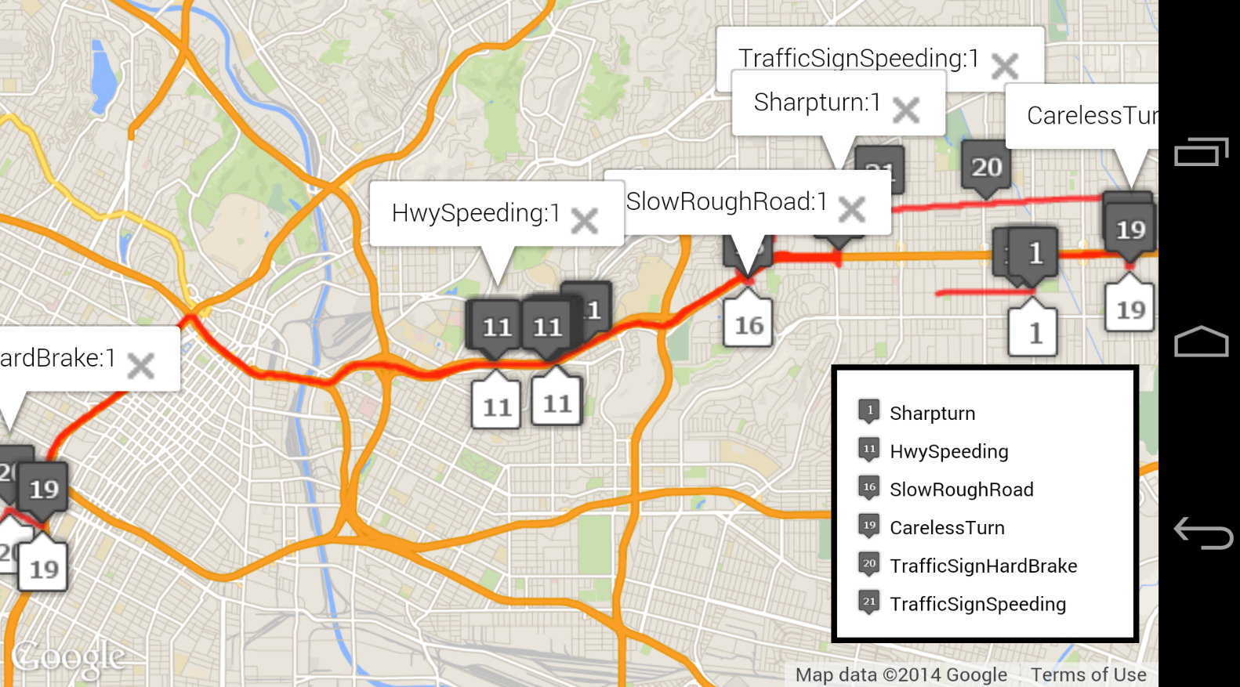
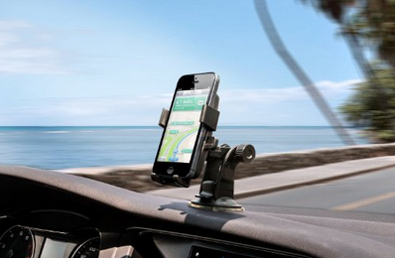
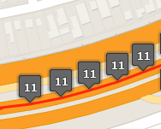
CARLOG in Action
Concurrent Events
TrafficSignSpeeding
CarelessTurn
16 Sensor
7 Cloud
CARLOG
Naive
HwySpeeding
TrafficSignHardBrake
SharpTurn
SlowRoughRoad
CARLOG detects more events than naive strategy
Naive
E1
E2
E3
CARLOG
E1
E2
E3
E4
E6
E5
Motivation
Problem
Design
Conclusion
Evaluation
Notes:
Our first experiment demonstrates the functioning of CarLOG, and compares it with the Naive Datalog predicate evaluation.
To run this experiment, we mounted a mobile device on the dashboard, and we installed 6 rules. The 6 rules contains 16 car sensors and 7 cloud predicates, and detect concurrent events.
We execute two evaluation strategies: Naive, which acquires predicates in order, and CarLOG which uses the multi-query optimization described earlier.
In general CARLOG detects 4 times more events than naive, and has average response time of 9ms, comparing to naive’s 899 ms, which is 2 order of magnitude lower.
Naive can miss events. As shown here, CarLOG detects sharpturn, trafficsignbrake, and trafficsignspeeding, which naive failed to detect. Moreover, if we zoom in here, and it’s obvious that carlog detects hwyspeeding 5 times, while Naive only detects only once.
To see why carlog detect more events, we take a look at the evaluation process, each evaluation in Naive takes full amount of time while carlog short circuits most of the time, we see that CarLog evaluates rules more frequently than Naive, and therefore detects more rules.
NOTES:

Slide 23
Evaluation Metrics
Latency Ratio
$$\frac{strategy^{′}s average evaluation time}{CARLOG average evaluation time}$$
Event Ratio
$$\frac{num of events CARLOG detects}{num of events strategy detects}$$
Motivation
Problem
Design
Conclusion
Evaluation
Notes:
In the rest of the talk, I will present results comparing CarLOG to other strategies. Based on the discussion from the previous slide, we define two performance metrics to compare strategies:
Latency ratio, which is the average evaluation latency of a strategy compared to that of CarLOG, and event ratio which is the ratio of CarLOG’s detected events to that of the other strategy.
If a strategy performs as well as CarLOG, both of these metrics have a value of 1.

Slide 24
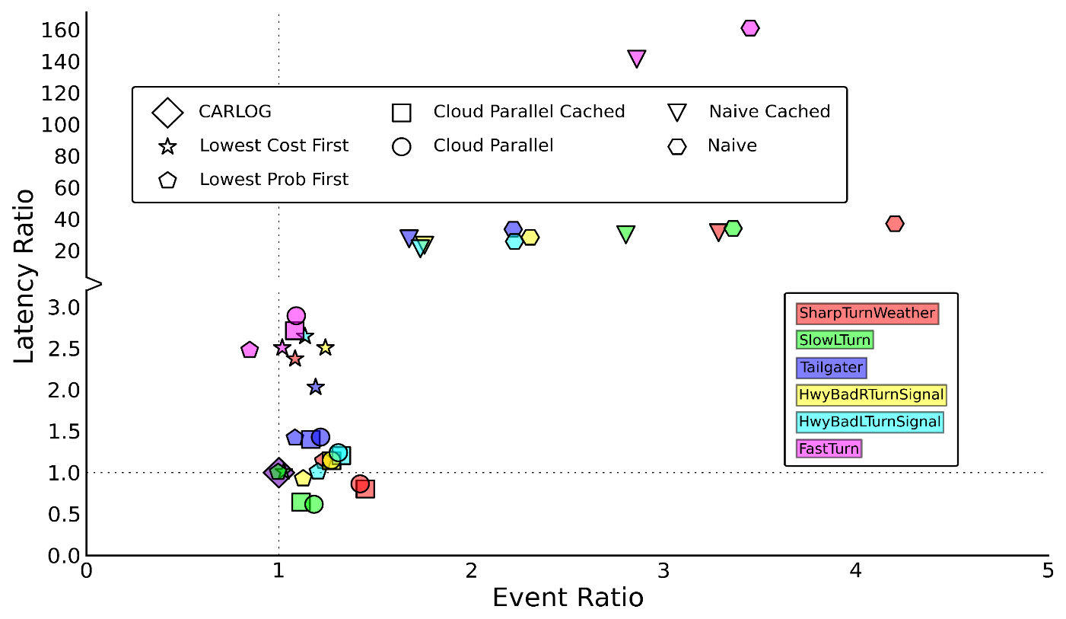
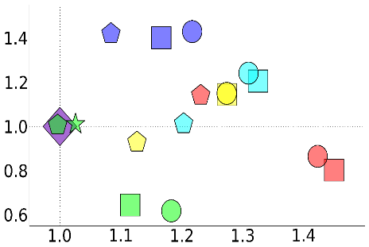
CARLOG Evaluation
CARLOG
Lowest Cost First
Lowest Prob First
Naive
Cloud Parallel
Naive Cached
Cloud Parallel Cached
Single queries with 3 cloud predicates
Lower event ratio but higher latency ratio
Lower latency ratio but higher event ratio
CARLOG Strictly Better !
Motivation
Problem
Design
Conclusion
Evaluation
Notes:
We compare carlog to several other strategies:
Lowest cost first evaluates the lowest cost sensors first, lowest prob first orders predicates by probability,
Naive waits for all the sensors to be sequentially retrieved before evaluating, while cloud parallel fetches all cloud predicate in parallel.
Cache locally stores some cloud information such as road speed limit, road curvature, weather, which can lower acquisition cost.
We grouped the queries by the number of cloud predicates, and show the queries with 3 cloud predicates. The x axis is the event ratio, and y axis is the latency ratio.
We find that CarLOG is strictly better than other strategies: if a strategy were better than CarLOG, it would be in the shaded area less than 1.
Some strategies, such as Cached and Cloud parallel have better latency performance with less than 1 latency ratio, but not better event detection performance. Conversely, some strategies, like Lowest probability have, for some rules, better event detection performance, but not better latency than CarLOG.
NOTES:

Slide 25
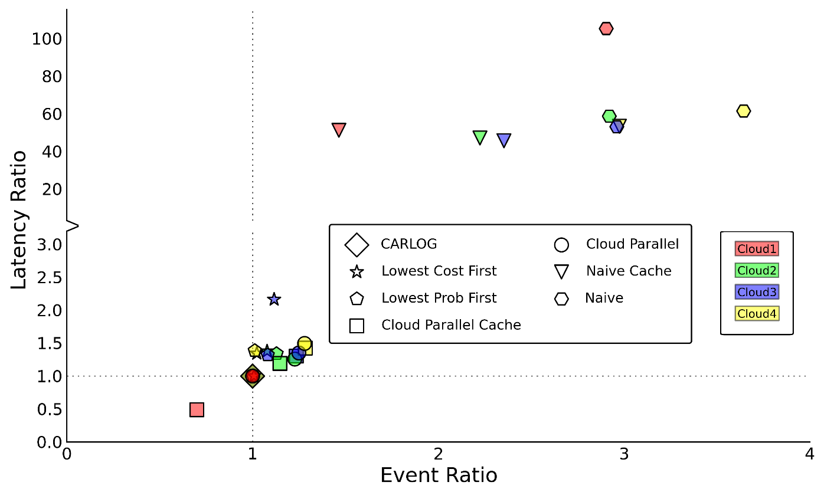
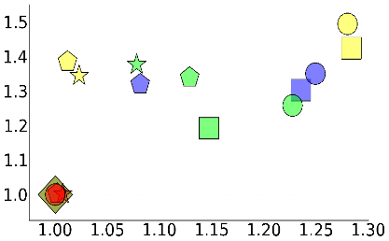
CARLOG Evaluation
CARLOG
Lowest Cost First
Lowest Prob First
Naive
Cloud Parallel
Naive Cached
Cloud Parallel Cached
Single query grouped by # of cloud predicates
> 30% MORE events
No other strategies dominate CARLOG
Cloud1 Cacheable Sensor
Motivation
Problem
Design
Conclusion
Evaluation
Notes:
This slide presents the data in a slightly different way. We then group the queries by the # of cloud predicates. Red means queries with only 1 cloud sensors, green means queries with 2, purple 3, yellow is 4.
When grouped this way, the only strategy that outperforms CarLOG is caching, but only for rules that have 1 cloud sensor.
For multiple cloud sensors, other strategies are not comparable to carlog and Carlog detects 30% more events on average than these.

Slide 26
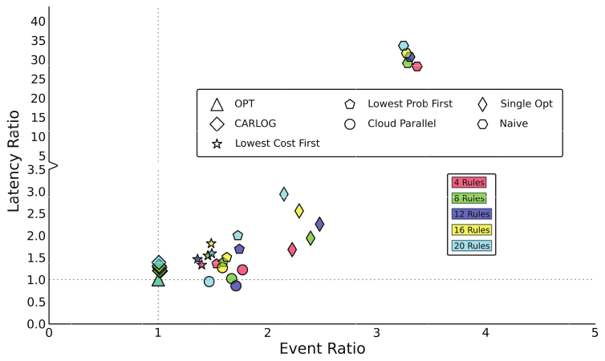
CARLOG Evaluation
CARLOG
Lowest Cost First
Lowest Prob First
Naive
Cloud Parallel
OPT
Single Opt
Multi-query performance
20% ~ 50%
> 30%
Motivation
Problem
Design
Conclusion
Evaluation
Notes:
CarLOG’s multi-query optimization also outperforms other strategies.
To show this, we introduced 2 additional strategies. OPT is globally optimal and computed using brute force technique. Single Opt evaluates rules individually
In this figure, we compare the performance of these strategies for different numbers of rules
We compare all other strategies including carlog to the OPT, and we find that CarLOG is 20% to 50% more latency than OPT, but gets almost same event ratio. This says our heuristic algorithm works very well in our setting. Moreover, carlog and OPT detects 30% more events than other strategies.
NOTES: Change to figure, highlight the numerical events in figure.

Slide 27
CARLOG Evaluation
CARLOG
Lowest Cost First
Lowest Prob First
Naive
Cloud Parallel
OPT
Single Opt
Multi-query performance
~ 50%
CARLOG scales well and achieves near optimal performance
~10X
Motivation
Problem
Design
Conclusion
Evaluation
Notes:
Moreover, as the number of rules increases from 4 to 20, the latency only increases by 50% for CarLOG, but the number of detected events increases by an order of magnitude. This shows that CarLOG scales well and achieves near optimal performance.

Slide 28
CARLOG Summary and Future Work
detect events in near real-time for automotive apps
adopt novel optimization algorithms for minimizing the predicate acquisition cost
succinctly express fusion of vehicle sensor and cloud information
CARLOG: Flexible and Efficient Automotive Sensing
Adaptive learning of probability and cost
Future work
More problem settings, e.g. multiple queries w/ negation
Large scale deployment of CARLOG
Motivation
Problem
Design
Evaluation
Conclusion
Notes:
In summary, we have presented carlog, a flexible and efficient automotive sensing platform.
It can succinctly express fusion of vehicle sensor and cloud information, and
can detect events in near real-time for automotive apps.
Finally, it adopts novel optimization algorithms for minimize the predicate acquisition cost.
In future work, we will consider adaptively learning of probability and cost, which incorporates the diversity of drivers and driving areas. Second, we will focus on more complete problem settings, such as multiple queries with negation. Finally, we hope to get some experience with carlog in real large scale system.
NOTES: add future work, deployment, and different parameters, training, multiple query w negation

Slide 29
Thank you
Notes:
Thank you and I am ready to take questions

Slide 30
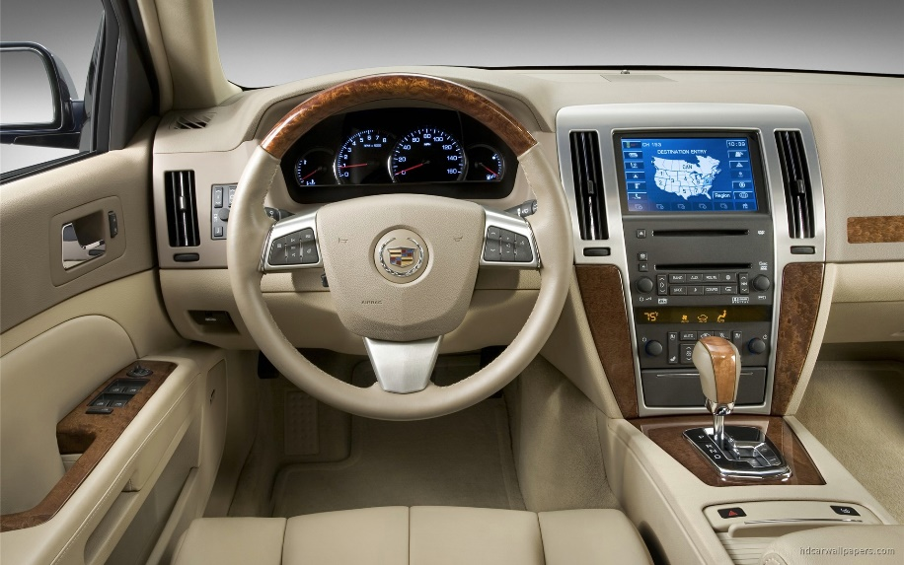
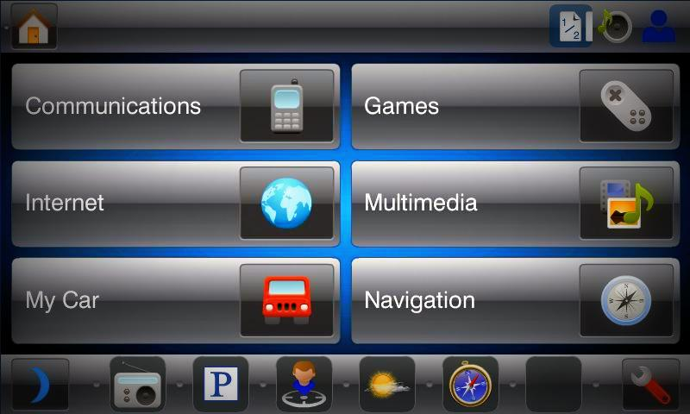
Automotive Platform
More Apps are coming to Automobile Platform!
Motivation
Problem
Conclusion
Evaluation
Design
Apple CarPlay
Notes:
Cars have been an important part of our life, people have begun to put more effort to make them more than transportation tools
Let’s take a look at the vehicle internal, most modern car comes with infotainment system, with development of operating system, such as android auto and car play, more and more apps are developed for car infotainment system. We can expect in the near future, more apps are coming to automobile platforms

Slide 31
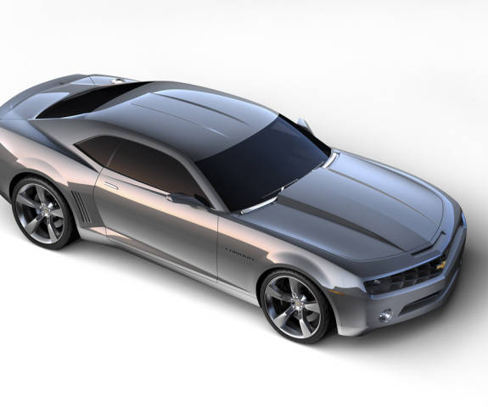
Introduction
Automobiles
Rich sensing for vehicle dynamics
On-board sensing
Cloud
Vehicle related Information
Network accessible
Focus: Programming context descriptions using information from the cloud and car sensors
Motivation
Problem
Conclusion
Evaluation
Design
Apple CarPlay
Notes:
Rich sensing information of low-level vehicle dynamics can be easily accessed through on-board sensing,
On the other hand, cloud provides all kinds of information we want, such as map, traffic, and those information are easily accessible from automobiles with network connectivity.
Considering those two aspects, we are focusing on programming context descriptions using information from the cloud and car sensors,
Talk slowly,

Slide 32
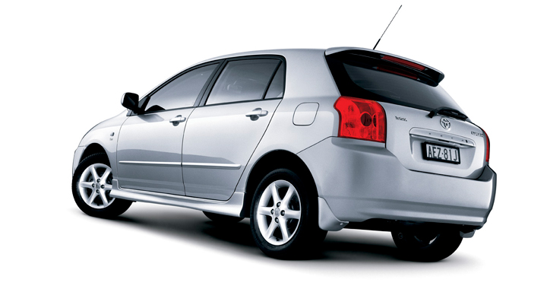
Contribution: CARLOG
Fusion for Context Sensing
Automotive Sensing
Wireless Connectivity
CarLOG: A flexible and efficient automotive sensing platform enabling near real-time event detection programming
Motivation
Problem
Conclusion
Evaluation
Design
Notes:
Our paper consider the scenario of automotive sensing together with network connectivity for cloud information sensing, and try to fuse both information for context sensing.
We proposed carlog, a flexible and efficient automotive sensing platform, which enables near real-time event detection programming for vehicles.

Slide 33
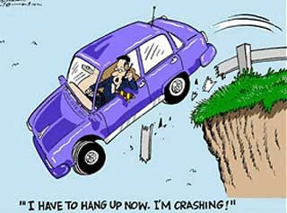
What if you want to program an automotive app?
OK, Let’s define a dangerous driving context
I have to sense vehicle dynamics
Oh, I need some phone sensors
Umm, cloud info may help
Wow, too complex!
Forget it, drive carefully
Avoidable?
Wait! Let’s look at CARLOG !
Motivation
Problem
Conclusion
Evaluation
Design
Notes:
Let’s see a scenario, a driver get crashed bcz of distraction from phone call, is this avoidable and prevented? call blocker will help, when u r driving like this, you should never allowed to get a phone call,
how can we recognize this context of dangerous driving?
? Ok, first, let’s define a dangerous driving context, you realized that u have to sense vehicle dynamics, then you realized I need have some phone sensors, further more, cloud information such as traffic, road condition, will be a plus. Then you realized it’s too complex to do, finally, your decision may be this.
BUT, wait, we are going to introduce a platform which solves all those issues!
Notes: tight back context

Slide 34
Single Conjunctive Query w/ Negation
Decision Tree
R$\left(x,y,z\right):−$ G$1\left(x\right), NOT{ R}_{1}(y,z)$
$R_{1}\left(y,z\right):−$ G$2\left(y\right),G3(z)$
$$G2$$
R
$$G2$$
Y
N
NP
NOT
Y
N
$$G3$$
$$G1$$
G1
$$R_{1}$$
$$G1$$
$$G3$$
Y
N
Y
N
$$p_{1}$$
$$0$$
$$G1$$
Y
N
Y
N
$$1$$
$$C_{1}$$
G2
G3
Linear Optimal Evaluation Algorithm:
$$0$$
$$G1$$
$$p_{2}$$
$$p_{3}$$
Y
N
$$1$$
$$0$$
$\left(G2, G3\right) for R_{1}, C_{R_{1}}=E\left(G2,G3\right),$
$${ p}_{R_{1}}=1 −\left(p_{3}∗p_{2}\right)$$
(G1, $R_{1}$) $for$ R
$$C_{2}$$
$$C_{3}$$
$$1$$
$$0$$
Y
N
$$1$$
$$0$$
More details in the paper
$$…$$
Motivation
Problem
Evaluation
Conclusion
Design
Notes:
Now, what if there is negation inside the rules? Here is what a negation looks like, It’s helpful , we know datalog can only be expressed in AND relation, so it’s hard to express a rule which contains or, in this case, we can substitute with a NOT which will compensate it.
In this case, we see that R1 is a subrule defined with G2,G3, we expand the proof tree as usual, but the difference is the link becomes NOT, which means G1 is false then G2 can consider G1.
We proved the problem to be NP complete,
we consider a special case where G1 cannot be interleaved between G2 and G3 (show this with an animation). Then say: for this special case we can compute an optimal ordering, by computing the effective probability and effective cost of the negated subtree (for this, skip the math, and show it with words). Then we apply the previous algorithm: (here you can show the math from the previous algorithm).
and we proposed a linear optimal evaluation algorithm, which is based on nested evaluation,
First calculate nested negated subtree like R1, and recursive calculate the expected minimum cost for the complete tree.
The output of the algorithm is a decision tree, not a deterministic evaluation order.
More details can be found in the paper

