Slide 1
CARLOC: Precisely Tracking Automobile Position
Yurong Jiang, Hang Qiu, Matthew McCartney, Gaurav S. Sukhatme, Marco Gruteser, Fan Bai, Donald Grimm, Ramesh Govindan
Notes:
Thanks for session chair’s great introduction, This talk is the last barrier to today’s lunch. Hope you bear my talk.
//Hello, everyone,
my name is Yurong Jiang, from university of southern california.
Today I’m going to talk about how we take advantage of car sensors and crowd-sourcing to improve the automobile positioning.
This is a collaboration with GM research and Rutgers university.

Slide 2
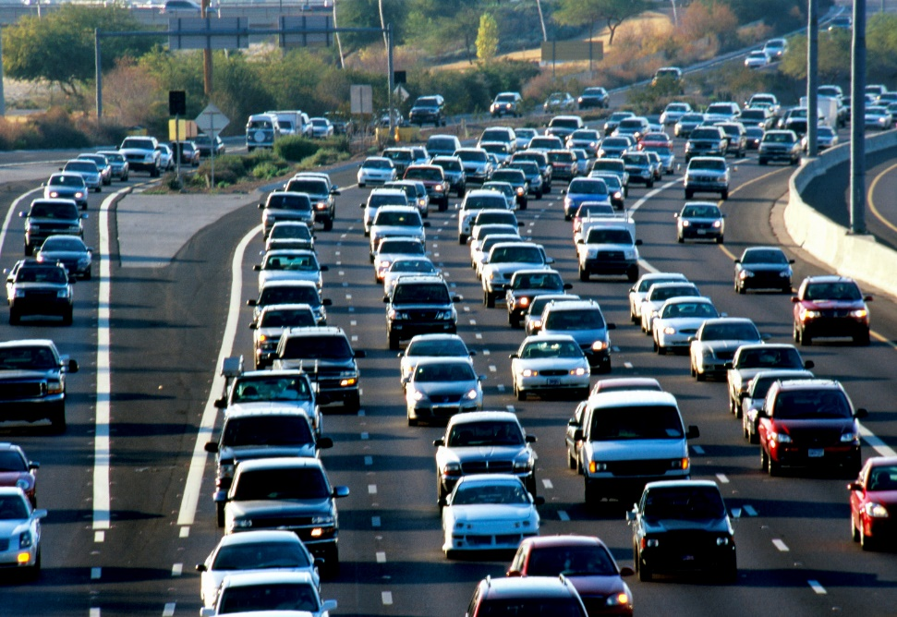
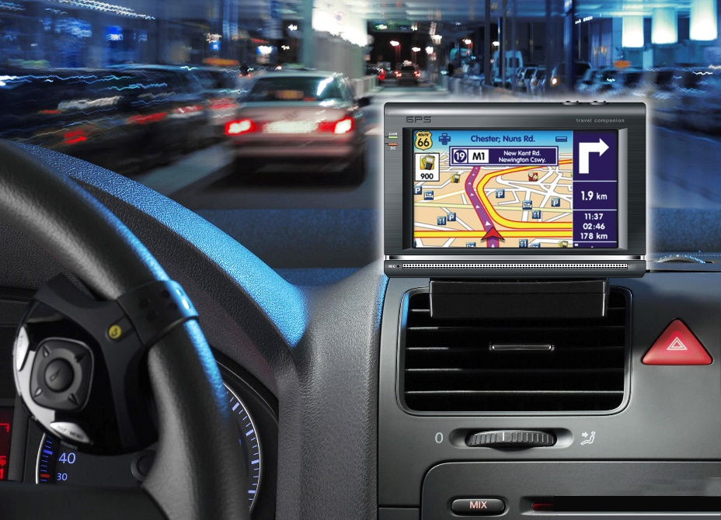
Importance of GPS for navigation
253 million passenger vehicles
on U.S. roads [rita.dot.gov]
77% of US vehicles traveling use GPS for navigation [LandAirSea.com]
Motivation
Problem
Conclusion
Evaluation
Design
Notes:
Precise positioning for vehicles is very important in our daily life.
According to bureau of transportation, there are over 253 million passenger vehicles on U.S. roads.
And more than 77 percent vehicles traveling in U.S. are using GPS.

Slide 3
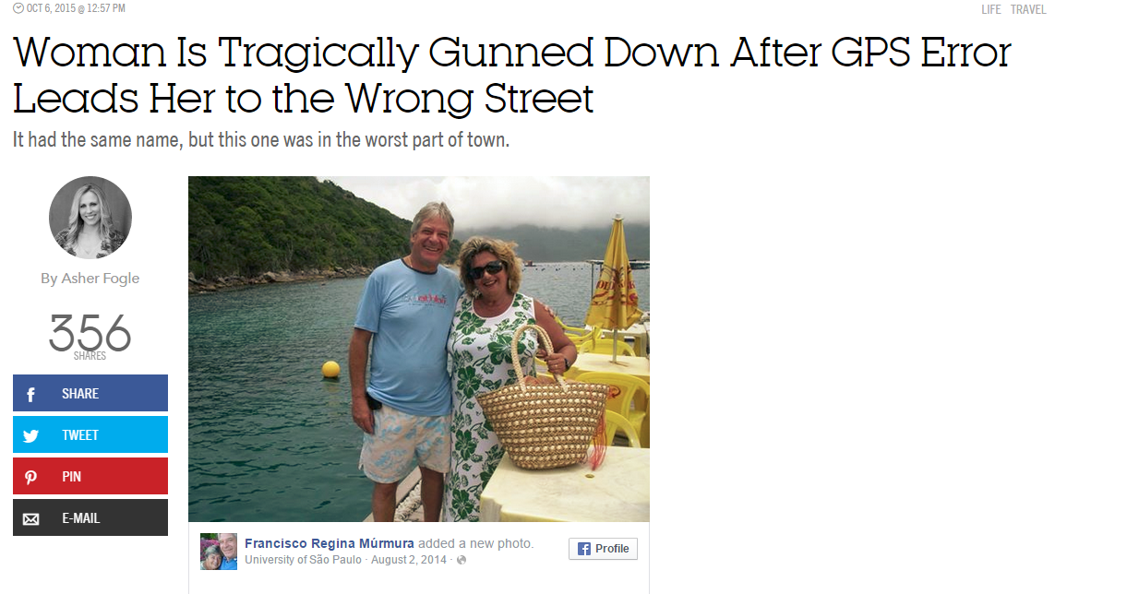
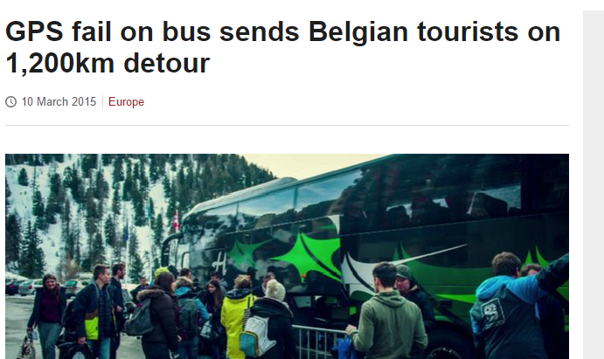
Impact of GPS Errors
GPS errors can sometimes have serious consequences
Motivation
Problem
Conclusion
Evaluation
Design
Notes:
GPS errors are prevalent and can sometimes have serious consequences.
Here are some articles that show GPS errors can be fatal. Also the well known google self-driving car is said lane-width accuracy is essential and hard to achieve in many cases.
Therefore, increasing GPS accuracy is very important.
%As GPS become more and more prevalent in our daily life, the error consequences need more attention.
RG: Nice slide

Slide 4
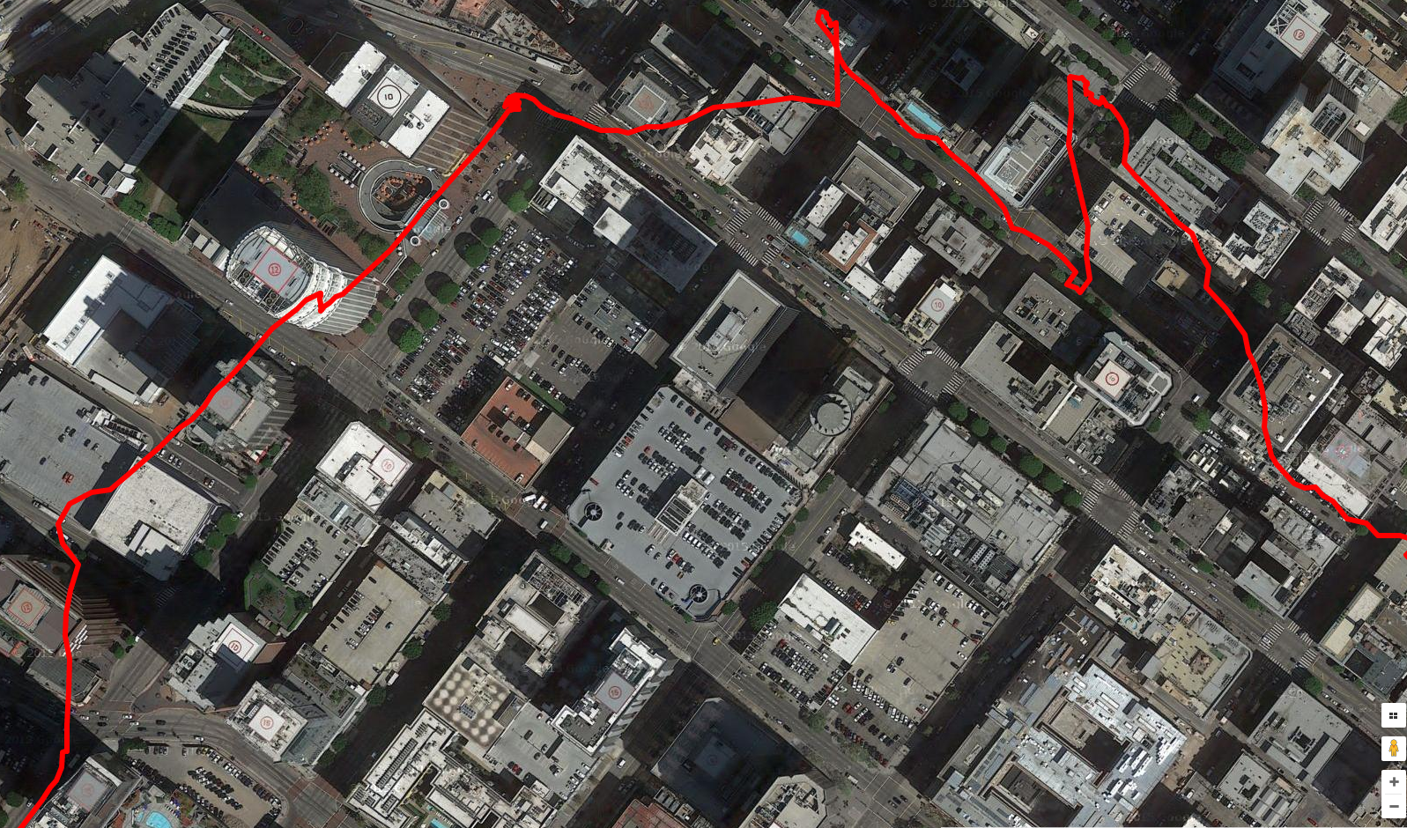
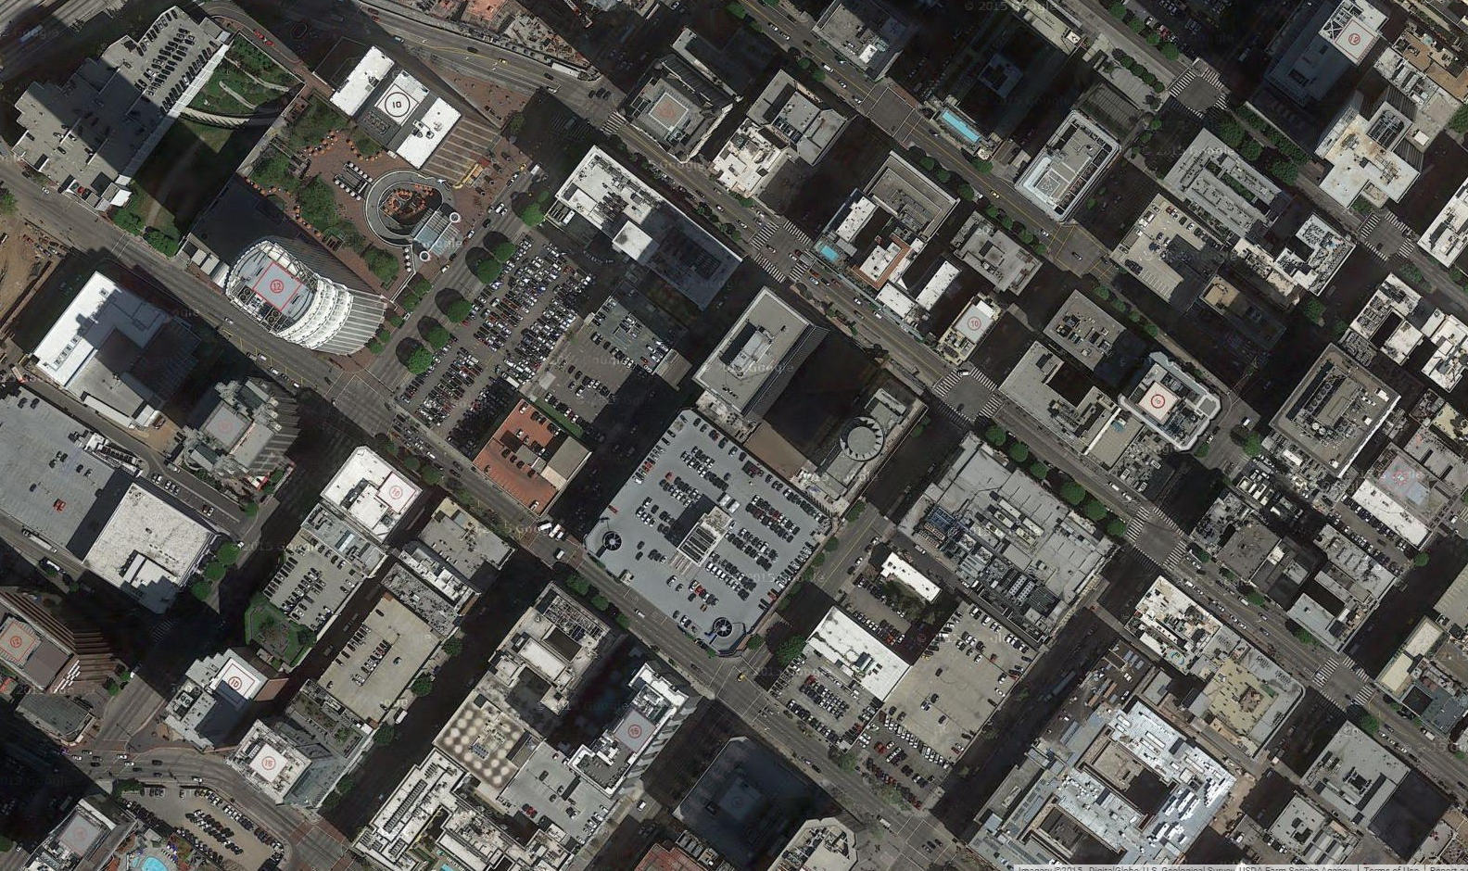
GPS Reading in Downtown
High-precision GPS - ublox NEO-7P
Smartphone (Google API) | Urban Area | Shaded Area | Opensky Area
Avg Error (m) | 24.3 | 15.3 | 4.7
Error Std (m) | 5.5 | 3.2 | 1.6
Motivation
Problem
Conclusion
Evaluation
Design
Notes:
We did an experiment to quantify the gps error in downtown area,
The car start from this point, and follows the traces shown in the map. The orange arrows basically shows the actual driving trace of the car.
However, we are surprised to see the actual high-end GPS reading looks like this, the red line here. which is really erroneous. Notice that, this is the reading from a high-end NEO-7P GPS.
Actually, we did more extensive measurement for smartphone GPS errors in three different situations.
The average errors in urban areas is over 20meters, while in shaded area, the error can reach 15 meters.
BACKUP:
Let’s take a look at the GPS performance in an obstructed area such as downtown.
We’re curious to see what would be the performance for high-precision GPS?
urban area where routes are obstructed with tall buildings, shaded area where routes are partially obstructed with some buildings and trees, and opensky area, where no obstructions.

Slide 5
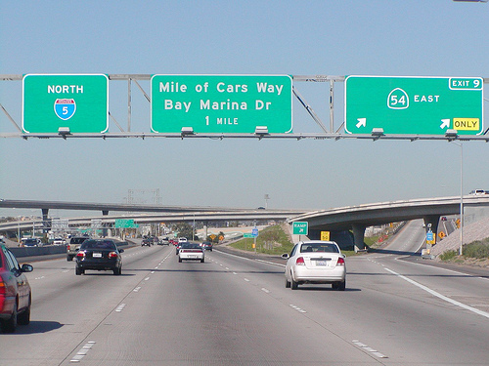
Goal
Can we achieve lane-level accuracy?
3 ~ 4 m
Motivation
Problem
Conclusion
Evaluation
Design
Notes:
In USA the lane width is usually 3-4m, but in many situations, the GPS error can reach multiple lanes.
So a question is can we achieve lane-width accuracy?
Lane-width accuracy can help improve many scenarios, such as lane-assistance, land surveying and autonomous driving.
BACK:
Our goal here is to achieve lane-level accuracy.
..

Slide 6
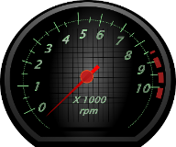
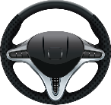
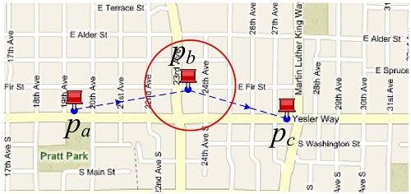
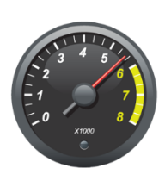
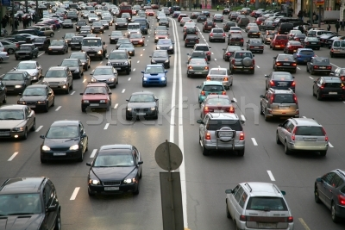
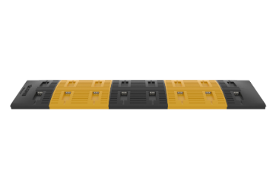
To achieve lane-width accuracy
GPS Errors
Process of calculating current position from previous position based on speed and course (heading)
Onboard Sensors
Dead
reckoning
Map
Map Matching
How to incorporate different techniques?
How to detect and use landmarks?
Crowd-Sourcing
Roadway
Landmarks
Motivation
Problem
Conclusion
Evaluation
Design
Notes:
To achieve such accuracy, in this paper, we use the following ideas.
First, we use the onboard sensors such as steering wheel angle, odometer to improve the dead reckoning. Before we continue, I’d like to briefly explain the dead reckoning: deadreckoning is common term in navigation which is the process of calculating current position from previous position based on speed and course over elapsed time.
Second, we incorporate digital map information, and use map matching to compensate the unreasonable gps error.
Next, we use the fact that many drivers come to landmarks like stop sign or the speed bump with similar pattern. We use their crowdsourced positions to make position estimation more accurate.
The key challenges are how to incorporate those different techniques and how to detect and make use of the landmarks.
BACKUP:
Change icon
we use sensing information and map information to detect some roadway landmarks, like ,,,,. Then we take advantage of crowdsourcing to improve the landmark accuracy.
Suppose car has an error gps reading, which can be significant sometime.
How can we compensate the errors?
One way we use is using onboard sensors such as steerwheel angle, odometer to improve the deadreckoning, which can help improve the accuracy.
On the other hand, we incorporate digital map information, and use map matching to compensate the unreasonable gps error
Next, we use sensing information and map information to detect some roadway landmarks. Then we take advantage of crowdsourcing to improve the landmark accuracy.
There are two challenges here:
1. How to incorporate different techniques to reduce overall error?
2. Which landmarks to use and how to detect and use them ?

Slide 7
CARLOC Contributions
4m max error in highly obstructed environments, improving GPS-only strategies by 10x
A common probabilistic position representation to incorporate different error reduction techniques
Enhanced position estimates by crowdsourcing positions of stop signs, speed bumps and right turns
Improved accuracy of dead reckoning and map matching using car sensors
Motivation
Design
Evaluation
Conclusion
Problem
Notes:
This paper makes 4 main contributions.
First, CARLOC uses a probabilistic position representation as a common framework to incorporate different error reduction techniques
Second, It uses onboard vehicle sensors in order to improve the accuracy of dead reckoning and map matching
Third: It enhances position estimates by crowdsourcing positions of roadway landmarks like stop signs, speed bumps and right turns
Finally, It achieves under 4m max error even in highly obstructed environments, improving the state of the art by an order of magnitude

Slide 8
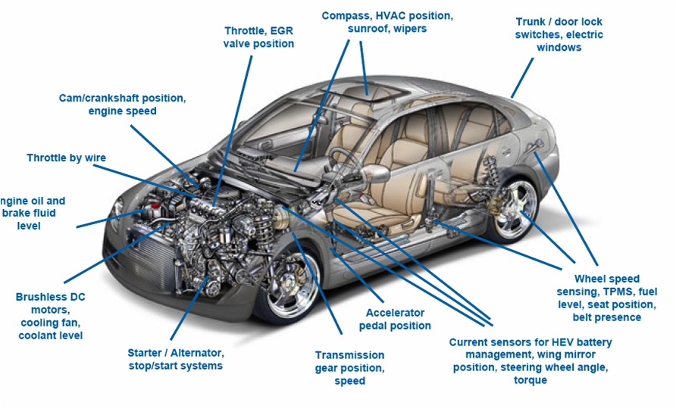
Key Insight: Use Car Sensors to Improve Position Accuracy
Automobiles come with hundreds of sensors
Motivation
Problem
Conclusion
Evaluation
Design
Notes:
All of those contributions are possible because of the key insight: use car sensors to improve position accuracy.
Vehicles are equipped with hundreds of sensors to monitor low level dynamics.
In our work, we used these 11 vehicle sensors to measure vehicle dynamics and road conditions. We carefully fuse those sensors and use them to improve our position estimates.

Slide 9
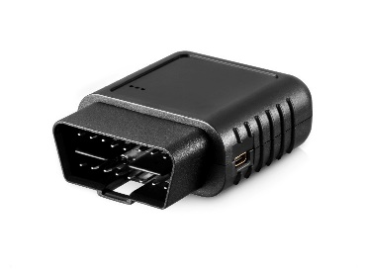
Key Insight: Use Car Sensors to Improve Position Accuracy
l
Steering Wheel Angle
Gear Shift
Driver Behavior
Throttle Position
Brake
l
Speed
Lateral Acceleration
Car dynamics
Yaw Rate
Vertical Acceleration
Engine Speed
l
Road Surface
Rough Road Magnitude
Motivation
Problem
Conclusion
Evaluation
Design
Notes:
We obtain the car sensor reading from vehicle through obdi ii port. Our sensing application in the phone read the sensor reading from Bluetooth.
In our work, we used these 10 vehicle sensors to measure vehicle dynamics and road conditions.
The first category describes the driver behavior, examples are steering wheel angle, gear shift, and so on
The second category describe the car dynamics, examples are speed and yaw rate so on.
The third category describe the road condition, like rough road sensor.
Group them: steering, gear shift, throttle, brake --- user behavior.
Speed, yaw rate, engine, lateral, verticl, ---- car kinematics (dynamics)
We carefully fuse those sensors and use them to improve our position estimates.
Rough-rm --- Road surface

Slide 10
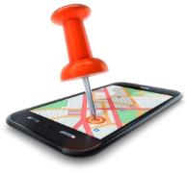
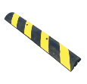
CARLOC Overview
l
Dead-Reckoning
GPS Update
Map-Matching
Crowd-Sourced
Landmarks
Motivation
Problem
Evaluation
Conclusion
Design
Notes:
Here is carloc system overview. At high level, CARLOC models the vehicle’s current position probabilistically. The key idea is to Refine the position with several ideas from different source.
1.One way that CARLOC reduces error is improving dead reckoning with built-in vehicle sensors. We’re able to obtain more accurate traveled distance and heading changes.
2. A second way to improve is to periodically obtain GPS readings. These readings are associated with estimates of error, which can be used to tighten the car’s position estimates.
3. To overcome GPS errors, one can spatially refine the position estimates using digital maps. Intuitively, a car is unlikely
to be off a roadway while driving.
4. The last component of CARLOC is based on the observation that roadway landmarks are consistently marked in the environment which can be exploited to refine the car’s position estimate.

Slide 11
CARLOC Challenges
Accurately modeling vehicle motion using car sensors
Representing position uncertainty due to sensor errors
Modeling uncertainty for GPS reading
Detecting roadway landmarks using car sensors and refining position estimates using crowdsourcing
Improving the accuracy of map matching algorithms using car sensors
Motivation
Problem
Evaluation
Conclusion
Design
Notes:
In designing these components of CARLOC, we faced several challenges which r discussed in the paper, I’m going to cover 4 of them
Let’s begin to talk our first challenge, which is ….
Add later
RG:

Slide 12
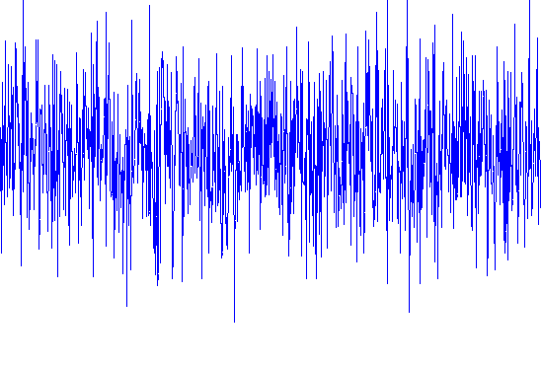
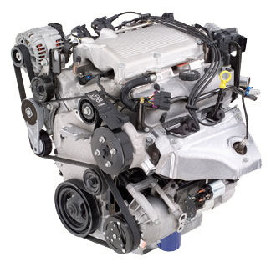
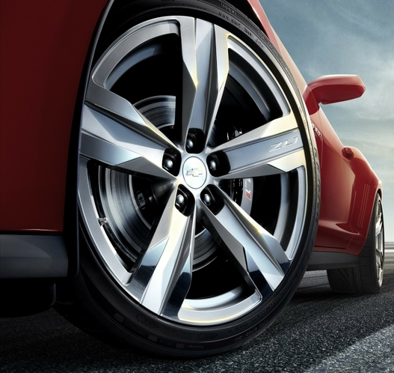
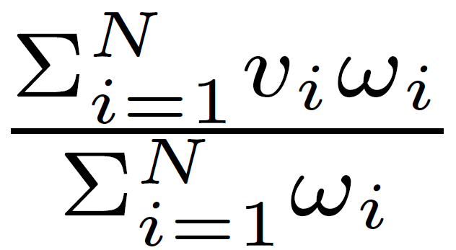
Representing Position Uncertainty
use a Probabilistic Representation
Particle Filter
$v=(x,y,θ$)
$v_{i}=(x_{i},y_{i},θ_{i},w_{i}$)
0.1
$(δ_{x}$, $δ_{y}$, $δ_{θ}$)
0.2
0.3
0.2
0.1
0.1
Motivation
Problem
Evaluation
Conclusion
Design
Notes:
when we get sensor readings from vehicles, such as odometer and steer wheel angle, those sensor readings are usually noisy.
One way to solve the problem is to use a probabilistic representation for those sensor readings
Traditionally, we represent a location with a single point, say (x,y,theta). This is often referred as pose vector. In probabilistic setting, instead of a single point, we represent a location with multiple points, each point is associated with a probability. In the figure, we show a simple example what the probability look like. this Every point represent a possible vehicle state vector.
This technique is commonly known as particle filter.
When vehicle moves from one state to another, we move all those points accordingly based on the input parameters.
We get the location by applying weighted sum.
Particle filter is the base technique in CARLOC, and in the next, I will discuss how we combine different techniques to particle filter to improve the accuracy.
RG:
Would it be better to show the word “Particle Filter” when you first show the particle filter?

Slide 13
CARLOC Challenges
Accurately modeling vehicle motion using car sensors
Representing position uncertainty due to sensor errors
Modeling uncertainty for GPS reading
Detecting roadway landmarks using car sensors and refining position estimates using crowdsourcing
Improving the accuracy of map matching algorithms using car sensors
Motivation
Problem
Evaluation
Conclusion
Design
Notes:
The next challenge is :Detecting roadway landmarks using car sensors and refining position estimates using crowdsourcing

Slide 14
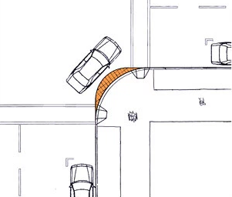
Roadway Landmarks
Stop Sign Landmark
Street Corner Landmark
Speed Bump Landmark
Motivation
Problem
Evaluation
Conclusion
Design
Notes:
We consider three types of roadway landmarks: stop sign landmarks, street corner landmarks, and speed bump landmarks.
Many other landmarks can be easily extended in our system.
In this talk, I’m going to give an example of crowd-sourcing for speed bump landmark.
RG
- Add pictures

Slide 15
Role of Crowdsourcing
How Landmark Crowdsourcing works?
Particle Cloud
Resampling
Car’s possible position
Motivation
Problem
Evaluation
Conclusion
Design
Notes:
Now let’s take a look how crowdsourcing works, we show speed bump example here.
When the first car passes the speedbump, we get a bunch of particles. Each particle represent car’s possible position. Car uploads its particles to the particle cloud. Then when the second car comes to the same speedbump, it resamples the particles from the particle cloud together with its own particles. Meanwhile, the particles’ weight in the particle cloud will update accordingly. When more car or trip come to the same landmark, we are getting more particles and further update the weight accordingly.
And we are getting a more accurate estimation of position as more crowdsourcing is introduced.
Particle cloud,
Combine original
Weight update. …
BACK;
Assume a single lane with speed bump as follows,
this is how a car parses the speed bump, (animation)
During the learning phases, we record the particles for this pass and uploads to particle cloud.
During the updating phase, when a second car comes, it uses it’s own particles and upload to particle cloud and resample to obtain its new particle cloud.
RG
- Change stop sign in figure to speed bump?

Slide 16
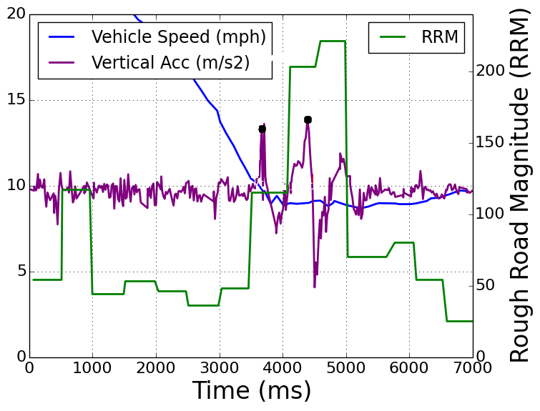
Speed Bump Detection
Speedometer
Speed Bump
Motivation
Problem
Evaluation
Conclusion
Design
Notes:
One challenge here is how to detect when a car passes a speedbump. Luckily a lot of car sensors can help detect speedbump
When car passing a speed bump, driver usually slow down first, which is indicated by speedometer reading. In actual sensor reading, we can see the
RG
-

Slide 17
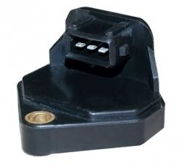
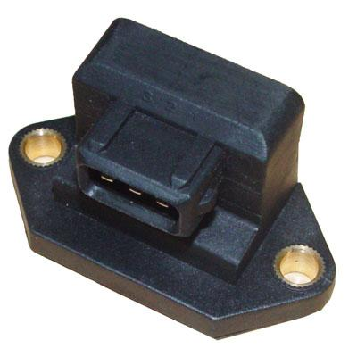
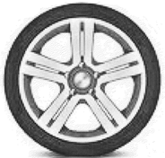
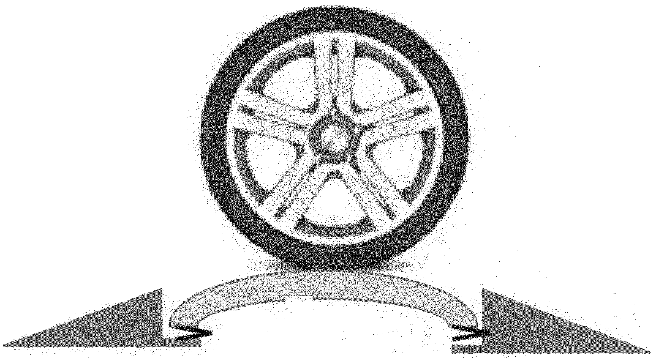
Speed Bump Detection
Speedometer
Rough Road Sensor
Acceleration Sensor
~ Car Length
Rear Wheel
Rear Wheel
Front Wheel
Front Wheel
Motivation
Problem
Evaluation
Conclusion
Design
Notes:
When wheel runs on top of the bump, the vertical acceleration and rough road sensors are expecting reading peaks.
Moreover, to distinguish the possible outliers such as potholes, we notice both the front wheel and rear wheel need pass the bump sequentially. We are anticipating to see two peaks. Moreover, the two peaks are usually within a car’s length.
Here are the actual reading from the sensors.
RG
-
What r two peaks,

Slide 18
CARLOC Challenges
Accurately modeling vehicle motion using car sensors
Representing position uncertainty due to sensor errors
Modeling uncertainty for GPS reading
Detecting roadway landmarks using car sensors and refining position estimates using crowdsourcing
Improving the accuracy of map matching algorithms using car sensors
Motivation
Problem
Evaluation
Conclusion
Design
Notes:
Next, I will talk about the third challenge that is how to accurately model vehicle motion using car sensors.
Add later
RG:

Slide 19
How to describe the motion?
Motion Model
Motion model captures how the pose of car evolves with time
Estimating displacement
Estimating change in heading
Key observation: Can estimate these parameters accurately using car sensors
Motivation
Problem
Evaluation
Conclusion
Design
Notes:
To get car’s position, we need an accurate motion model to capture car’s movement during the time.
To achieve this, we need a good estimation of car’s moving displacement and heading changes.
The key observation here is to estimate these parameters using car sensors.

Slide 20
Motion Model Parameter Estimation
Simplified displacement estimation
$$x_{t}=x_{t−1}+\frac{1}{2}(v_{t}+v_{t−1})δ_{t}$$
Odometer
Heading change estimation
Inertial Bearing?
Error in inertial sensors causes significant error in heading
Model Heading Change with Vehicle Kinematic Model
Motivation
Problem
Evaluation
Conclusion
Design
Notes:
We use this simplified equation to calculate the displacement. The inputs to the equation are obtained from odometer.
For heading change estimation, we could have use heading derived from inertial sensor’s gyro and acc reading, but we find the derived heading are erroneous which causes significant error in heading.
We find it’s necessary to model heading change with a vehicle kinematic model. .
BACK:
As a result, we need to model heading change carefully.
The technique we used is to model Heading Change with Vehicle Kinematic Model
RG
I didn’t understand the “Even inertial bearing…” part. What “advanced chip” are you talking about?

Slide 21
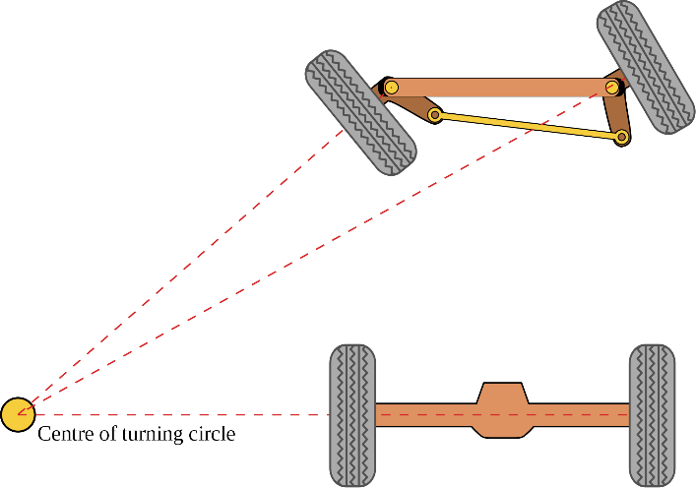
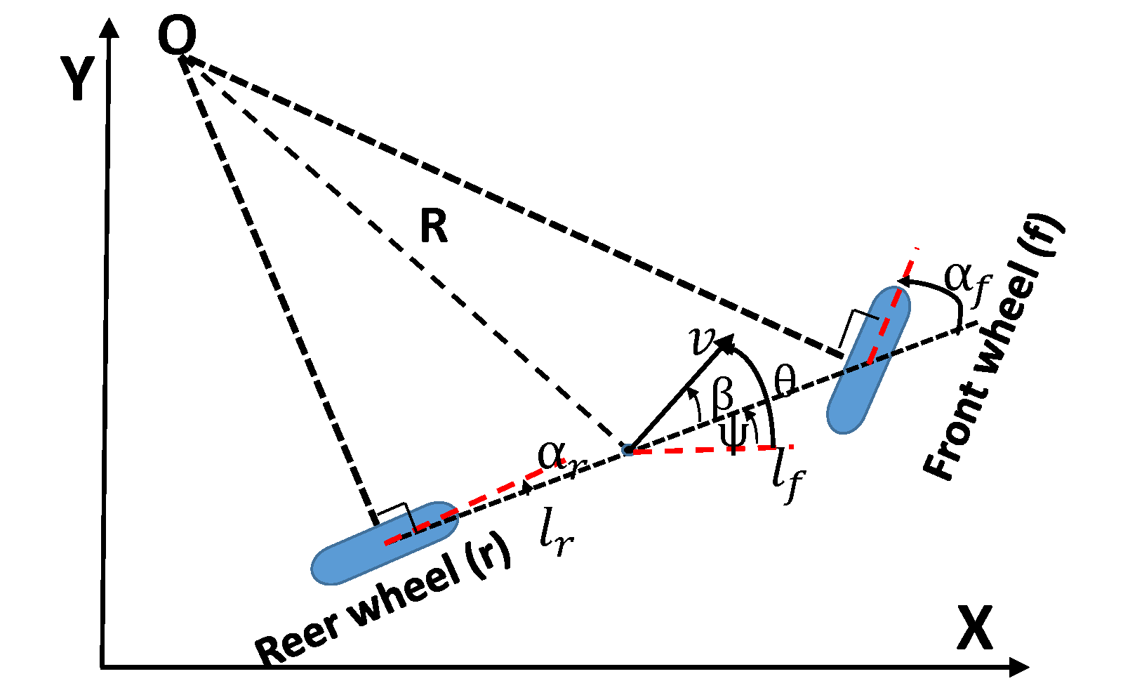
Heading Change Modeling
Ackermann Motion Model
Heading ($θ$) = Bearing ($ψ$) + Slip ($β$)
Yaw Rate
Steering Wheel Angle
$v_{i}=(x_{i},y_{i},θ_{i},w_{i}$)
${v′}_{i}=({x′}_{i},{y′}_{i},{θ′}_{i},{w′}_{i}$)
Motivation
Problem
Evaluation
Conclusion
Design
Notes:
Supposing a driver turn the steering wheel, what is happening is the front wheel changes shown in the figure. When the wheel turns, the actual change in heading is a very complex function, that is determined by something called Ackermann motion model.
The heading change is both a change in bearing and change in slip.
The key idea in our approach is we can compute the bearing change with yaw rate and slip change with steering wheel angle. When we do that, we apply the change to particles as shown.
The detailed computation is described in the paper
BACK:
Modeling heading change need careful understanding of the vehicle motion model.
Driver control the vehicle direction through steering wheel angle. Vehicle steering follows the Ackermann geometry which describes how turns are effected by steering.
The actual heading is the sum of bearing angle and slip angle,
The key observation here is that the bearing can be estimated from vehicle yaw rate sensor and slip angle can be modeled through vehicle steering wheel angle.
We use the car sensor readings to update the particle cloud on heading changes.
In the paper we have details of how we do this, but I’m not going to talk about it here.
RG
Still too much material on slide, break it up into 2-3 slides?
If you are short on time, we can omit this section

Slide 22
CARLOC Challenges
Accurately modeling vehicle motion using car sensors
Representing position uncertainty due to sensor errors
Modeling uncertainty for GPS reading
Detecting roadway landmarks using car sensors and refining position estimates using crowdsourcing
Improving the accuracy of map matching algorithms using car sensors
Motivation
Problem
Evaluation
Conclusion
Design
Notes:
Next, we talk about our last challenge: that is improving the accuracy of map matching algorithm using car sensors.
Add later
RG:

Slide 23
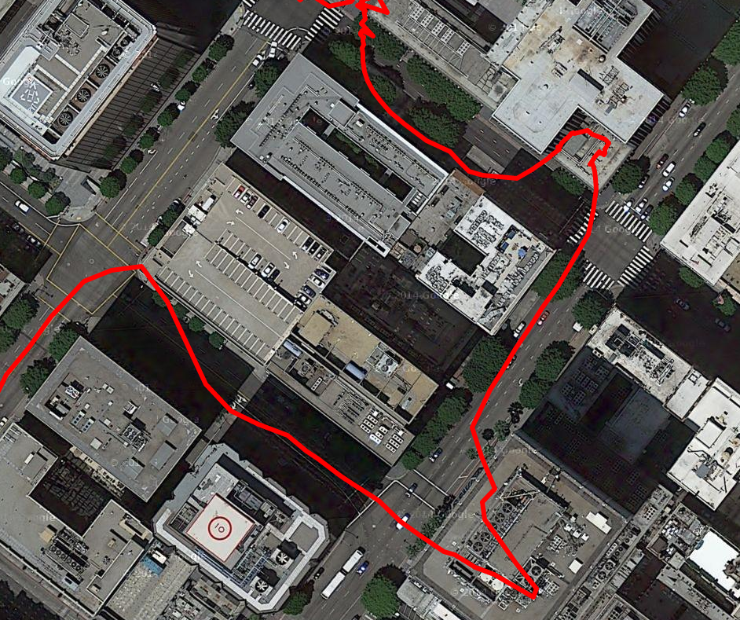
Map Matching
Road B
Road C
P
Road A
Map matching is a technique that integrates positioning data with road network to identify correct link on a digital map
Motivation
Problem
Evaluation
Conclusion
Design
Notes:
Before I discuss how we do map-matching, I’d like to tell you what map matching is. Map matching is a technique in GIS that associates a sorted list of user or vehicle positions to the road network on a digital map.
Let’s take a look at a real trace in the map, consider a point P at the trace, we can’t determine which road the car is at, especially the closest road segment is not always correct.

Slide 24
Hidden Markov Model (HMM) for Map Matching
How to distinguish?
1
Transition Probability
A
Travel Distance
Observation Probability
Yaw Rate
Steering Wheel Angle
0
Speed
Odometer
B
C
Car sensors give more accurate transition probability estimates
How to obtain accurate Observation and Transition Probability?
Motivation
Problem
Evaluation
Conclusion
Design
Notes:
I’m now going to show how we use car sensors to improve map-matching. Our map-matching is based on the hidden markov model. The inputs to Hidden markov model are observation probability and transition probability. The key challenge here is to get good estimation of transition probability. Assume we have two consecutive readings at times 0 and 1. Projecting them to closest roads can help obtain observation probability. To get transition probability, previous strategy use the distanced travelled in between. However, they usually get it using GPS to estimate distance, which is erroneous.
Instead, we use the car’s speed and odometer to obtain the distance. But we are still not able to distinguish the time 1’s projection. We use additional sensors like yaw rate and steering wheel angle to help solve this.
This helps assign more accurate transition probability probabilities, as we discuss in the paper.
The key takeaway here is Car sensors give more accurate transition probability estimates.
BACK:
Let’s see a road map like this, C is crossing A and B.
Assume we have two consecutive GPS reading at time 0 and 1. We know cars are driving on the road, which means, at time 0, it can be at road A or B, C. Similarly for the point in time 1. Based on the projection distance from the GPS point to the road, we obtain the observation probability.
Similar to traditional method, using the car speed and odometer sensor information, we can get the actual travel distance between the two point.
Assume we are able to filter out those two impossible points.
But traditional methods can not distinguish the rest two points here. As a result, we find we can use car sensors like yaw rate and steering wheel angle to find out, say the driver makes a right turn here. Thus we are able to exclude this point.
Those two conditions can be quantitatively represented as transition probability. Our map-matching algorithm uses Viterbi algorithm with transition and observation prob we discussed here. More details can be found in the paper
BACK:
Traditionally map-matching algorithm uses the idea of travelling distance and time, we know the car can’t be at A or B at time 0
Then , a question is how to determine time 1’s position, which both satisfy the condition, we find another condition we can utilize is car sensors,
for example, we know car makes a right turn, so car should be at A. not C. We takes driving behaviors for transition prob for Viterbi algorithms.
RG
The text “Incorporate…” is too vague. Can you replace with something more specific that also highlights which car sensors you use?
Also, it might be good to tie this in with the particle filter…
Existing strategy uses the travelling distance from odometry, we know the car can’t be at A or B at time 0

Slide 25
Map Matching Usage
B
A
$${w′}_{i}=w_{i}∗{\frac{1}{\sqrt{2πσ^{2}}}e}^{−\frac{d_{i}^{2}}{2σ^{2}}}$$
$$d_{i}$$
$v_{i}=(x_{i},y_{i},θ_{i},w_{i}$)
Motivation
Problem
Evaluation
Conclusion
Design
Notes:
CARLOC uses the result of map-matching in multiple ways, such as eliminating invalid GPS reading. But the most important usage is that we use map-matching to update the weights on the particle filter. The particle weight will be updated based on the distance to the road.
the weight of those particles far away from the road will shrink,
BACK:
First, when it starts up, CARLOC does not have a usable estimation of the vehicle’s position so it projects the GPS reading onto the map-matched road segment as a position Estimate
which affects their next sampling process.
Second,

Slide 26
CARLOC Evaluation
Methodology
Ground Truth
Trace-driven comparison
Under 3 different circumstances – Obstructed, Partially-Obstructed, Un-Obstructed -- from GPS view
Closed-loop routes for partially obstructed area
High-precision GPS Receiver for open sky area
Fiducials for obstructed area
Metrics
Position error measured by distance between CARLOC position and ground truth
Motivation
Problem
Design
Conclusion
Evaluation
Notes:
We talked about most of design of carloc, I’m now going to describe the carloc evaluation
Our evaluations are based on multiple traces collected by two different drivers over routes with different characteristics
from the perspective of a GPS receiver: obstructed routes in a downtown urban canyon, unobstructed routes with a view of
the open sky at all points, and partially-obstructed routes with obstructed sky visibility in some locations
Our measure of CARLOC performance is positioning error measured by distance between CARLOC’s position and ground truth.
However, obtaining ground-truth is extremely hard for positioning in some places. We used 3 approaches to get the ground truth depending on which area we are measuring,.
The metrics we used is position error. more details can be found in the paper.
Todo: Separate metrics and ground truth.
BACK
Instead, we resort to three approaches.
In our partially obstructed routes, we start the route at a well-marked location (and empty metered parking spot) and return to the same location. Our measure of accuracy then is the difference between the start position and the end position as reported by CARLOC. We calls this closed-loop routes
On our unobstructed routes, we also continuously collect readings from the high precision GPS receiver and use these as ground truth.
On our obstructed routes, as we show below, the accuracy of the high precision receiver is not sufficient. So, we resort to using fiducials in the environment.

Slide 27
CARLOC Evaluation Experiments
CARLOC Optimization Benefits
CARLOC Performance on 3 different situations
Obstructed Downtown Area
Partially Obstructed Area
Un-obstructed Open-sky Area
Crowd-Sourcing
Map-Matching
Motion Model
Landmark Roles
Landmark accuracy and detection accuracy
Crowd-sourcing degree impact on accuracy
Landmark number impact on accuracy
Motivation
Problem
Design
Conclusion
Evaluation
Notes:
Our evaluation covers three perspectives: carloc performance under 3 different situations. carloc optimization benefits and Landmark role in overall accuracy.
I’m not going to talk all of those experiments, I’m going to cover the following experiments.

Slide 28
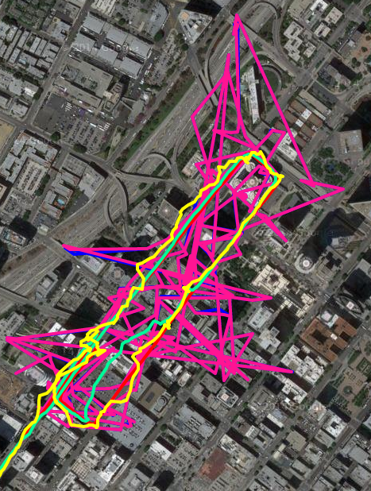
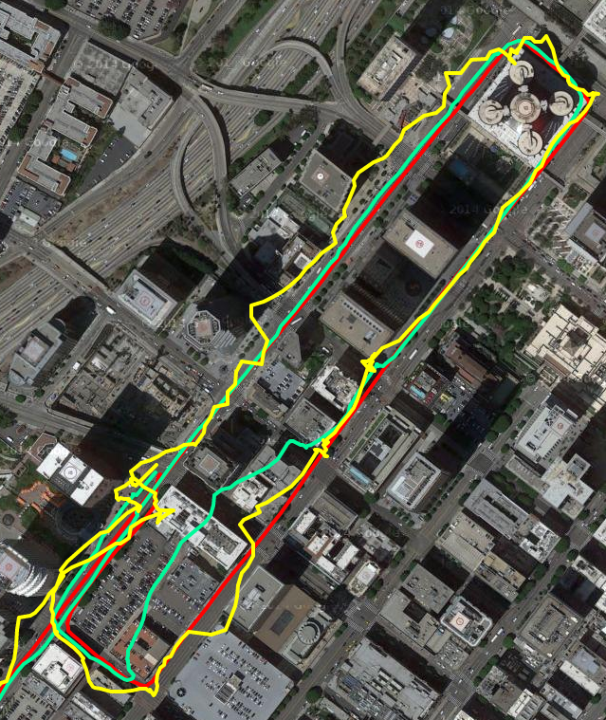
CARLOC and GPS Comparison in Downtown
CARLOC
Smartphone
High-Precision
RTK-GPS
Differential-GPS
Motivation
Problem
Design
Conclusion
Evaluation
Notes:
First, we show our strategy’s result in downtown area.
we compare CARLOC with 4 alternatives: smartphone, high-precision gps, and two other advanced GPS strategy: rtk-gps and differential-gps.
In the figure on the left, it is evident that DGPS and RTK measurements span the entire area covered by the two-mile loop.
In the figure on the right,
CARLOC clearly outperforms the high-precision receiver and the smartphone

Slide 29
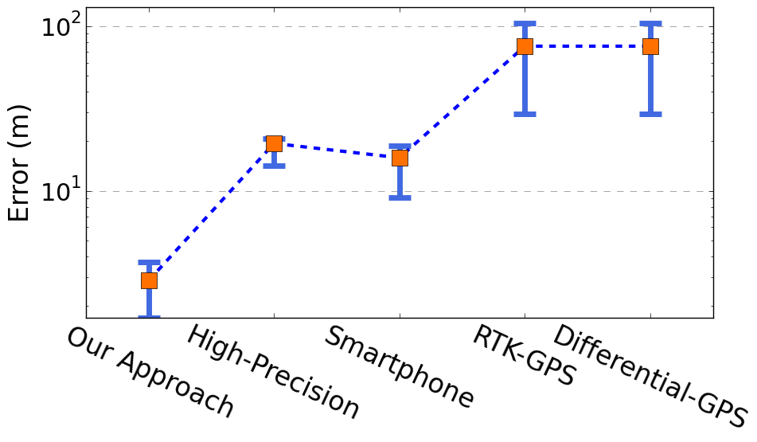
Map Pin Points Comparison
100
10
2.7 m
We also achieve better accuracy than GPS strategies for partially-obstructed and un-obstructed routes, details can be found in paper ...
Our Approach Brings 10x Improvement
Motivation
Problem
Design
Conclusion
Evaluation
Notes:
We now show the quantitative comparison. Our approach achieves average error of 2.7m, the error bar represents the 25th, and 75th percentile error.
For other strategies, high-precision gps has an average of 19.m and smartphone has an average of 16m with higher variance. Both RTK and differential gps achieves really poor performance with average error of 75m and 200m respectively.
CarLoc brings 10X improvement in accuracy.
We also achieve better accuracy than GPS strategies for partially-obstructed/un-obstructed routes and more details can be found in paper ...

Slide 30
Benefits of Optimization
Baseline GPS Error
W/O Map-Matching
Start-End Error (m)
W/O Motion Model
CARLOC
Each optimization has significant benefits
Route Length
Motivation
Problem
Design
Conclusion
Evaluation
Notes:
The optimization we did in carloc actually improves carloc accuracy significantly. Now we show how carloc performs when each optimization is removed.
The result is from partially obstructed road. The average GPS baseline error is around 6-8 meters.
CarLoc accuracy is around 1-2 meter in all routes. If we remove the motion model optimization, the error increases to 2-4 meters.
If we remove the map-matching, the errors are generally over 3 meters.
BACK
To check the optimization of carloc, we compare carloc with the optimization removed strategy. And show the result below.
Those two strategies exhibit significantly higher error between 3-3.5m across all our route lengths, suggesting that the optimization is definitely
beneficial.
What if remove un-optimized, unoptimized map-matching.

Slide 31
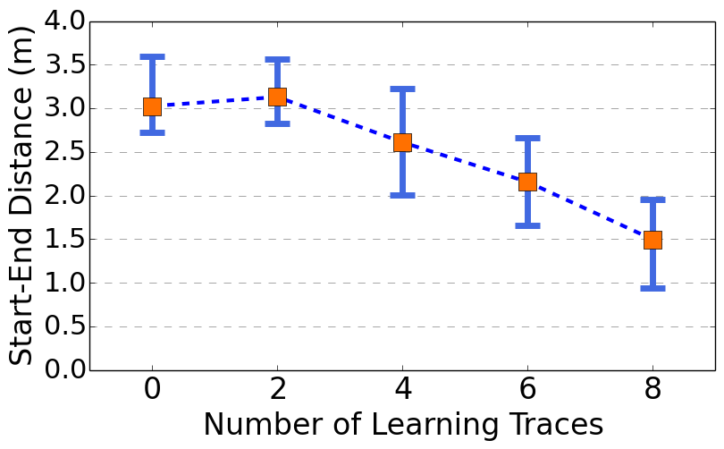
Benefits of Crowd-Sourcing
What degree of Crowd-Sourcing is necessary ?
CARLOC accuracy can be improved by adding a higher degree of crowd-sourcing
Degree of Crowd-Sourcing
Motivation
Problem
Design
Conclusion
Evaluation
Notes:
Next question is what degree of crowd-sourcing is necessary?
We show the error relationship for number of learning tracings. This indicates what degree of crowd-sourcing is necessary.
w/o crowd-sourcing, the avg error is about 3m, as degree of crowd-sourcing increases, the error keeps decreasing. In our 8 traces case, the error becomes only half of it, which is only 1.5m. The trend is that….
Explain x axis and y axis, change to 15.
Todo: add takeaway to slide.
BACK:
The result suggests that
CARLOC accuracy can be improved by adding a higher degree of crowd-sourcing.

Slide 32
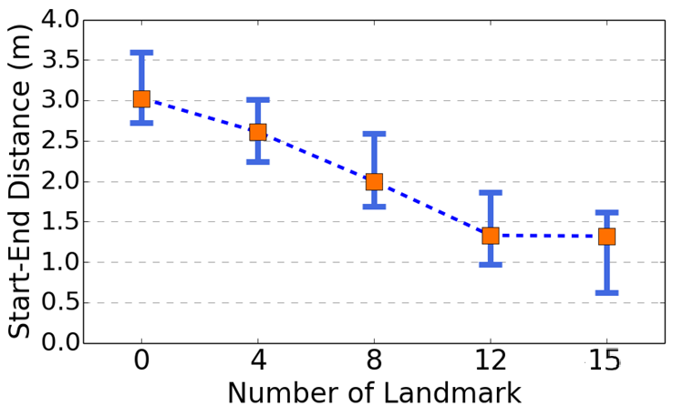
Role of Crowd-Sourcing
How many landmarks are enough?
10
Motivation
Problem
Design
Conclusion
Evaluation
Notes:
Last question is how many landmarks are enough. We show the CARLOC closed-loop error on our 5.3km partially obstructed route.
On this route there are 15 landmarks in total, and the figure plots mean CARLOC error as a function of the number of landmarks used to calculate position.
As expected, the error decreases as more landmarks are used in estimating position. However, beyond about 12 landmarks there is no obvious improvement in the error, suggesting that of a relatively small number of landmarks along a route might be sufficient to achieve high accuracy
Q: what’s happening for 12..

Slide 33
CARLOC Contributions and Summary
A common probabilistic position representation to incorporate different error reduction techniques using car sensors
Enhanced position estimates by crowdsourcing positions of roadway landmarks
Extensive evaluations on roads with varying degree of satellite obstructions, improving GPS-only strategies by 10x
Motivation
Design
Evaluation
Conclusion
Problem
Notes:
In Summary, This paper makes three main contributions.
First, CARLOC uses a probabilistic position representation as a common framework to incorporate different error reduction techniques
Second, It enhances position estimates by crowdsourcing positions of roadway landmarks like stop signs, speed bumps and right turns
Finally, carloc is evaluated on roads with evarying degree of satellite obstructions and result shows the improvement to state of the art by 10x
Thank you and I am ready to take questions

Slide 34
Thank you
Notes:
Thank you and I am ready to take questions
Similar
Crowd-sourcing and landmarks, reorder,
System design, how this technique combine existing technique.
Localization expert, “state of art”, map-matching should be included, 10times,

